Slide 1
Bridge Data Protocols for Interoperability
and Life Cycle Management
Work-in-Progress
Stuart S. Chen, Ph.D., P.E.
UB Bridge Information Modeling Research Group
Hanjin Hu, P.E., Ph.D. Candidate, LEED Green Assoc.
Najaf Ali, Ph.D. Candidate
Rohit Srikonda, P.E., MSCE, M.S. Candidate in CSE
Department of Civil, Structural and Environmental Engineering
University at Buffalo
June 2013
Local Failure

Slide 2
Research Tasks
Task 12.1: Literature and Practice Review
Task 12.2: Multi-Year Implementation Roadmap
Task 12.3: Analysis of Bridge Activities
Task 12.4: Identifying Information Items
Task 12.5: Prototype 3D Viewer/Modeler
Task 12.6: “Manual of Translator Development”
Task 12.7: Demonstration Project
Task 12.8: Training Mat’ls and Reporting

Slide 3
Vision & Bridge Lifecycle (Enterprise) Process Map
Vision of Multi-Year Implementation Roadmap
Practical Implementation
Information Technology (IT) facilitated interoperability throughout the entire bridge lifecycle
Model/Modular
Either a (set of bridge industry-specific) model(s) or a integral part of the larger Civil Integrated Management (CIM) (or NIEM?, or IFC(5?), or next-gen transXML, or …) umbrella

Slide 4
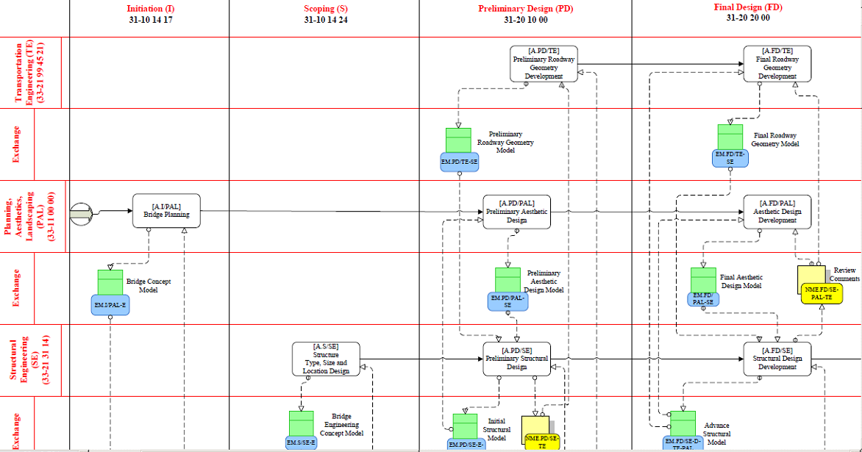
Vision & Bridge Lifecycle (Enterprise) Process Map
Process Map — Streamlined and Improved IT- enabled Managing Method
Portion of Bridge Enterprise Process Map (Chen et al. 2013)

Slide 5
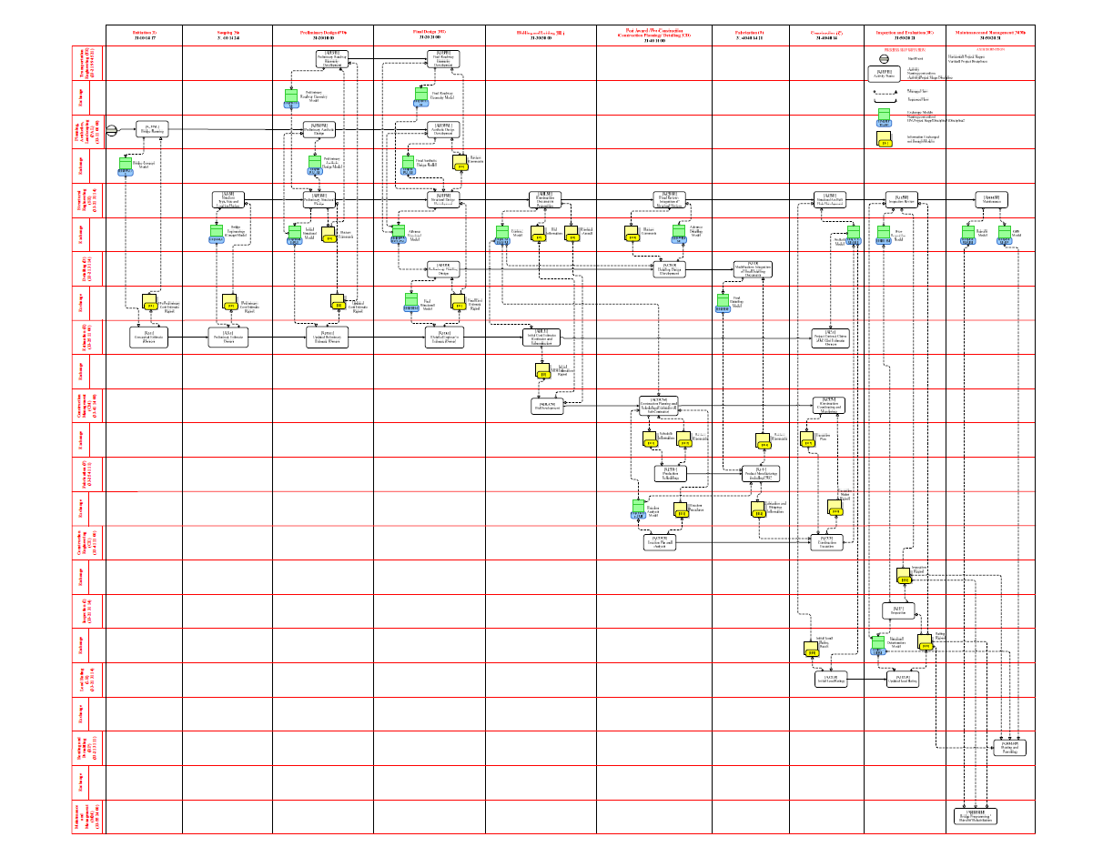

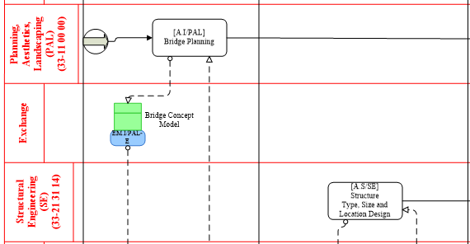
Process Map Notation
Project Disciplines:
Detailing
Estimating
Construction Management
Fabrication
Construction Engineering
Inspection
Load Rating
Routing and Permitting
Maintenance and Management
……
Project stages:
Bidding and Letting
Post-Award/Preconstruction Planning/ Detailing
Fabrication
Construction
Inspection and Evaluation
Maintenance and Management
Management
……

Slide 6
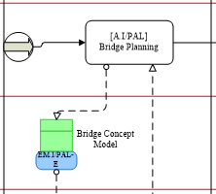
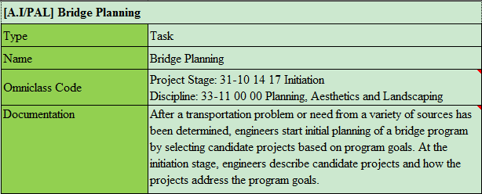
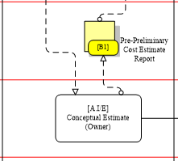
Process Map Notation
Activity Descriptions
Activity Description

Slide 7
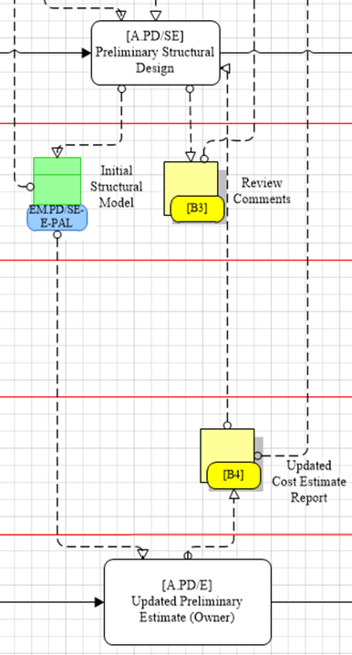
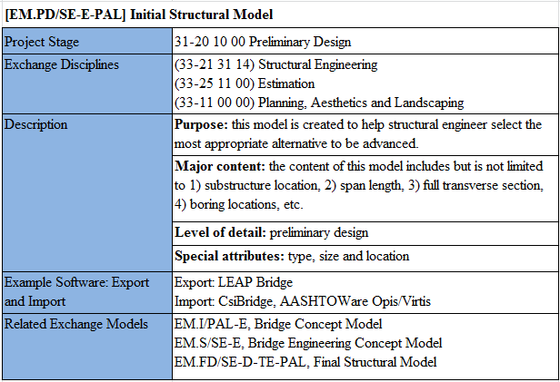
Process Map Notation
Exchange Model and Data Dictionary
Exchange Model Description

Slide 8
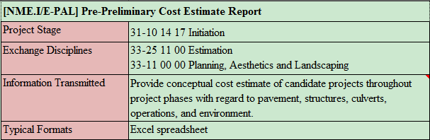
Process Map Notation
Non-model Exchange Descriptions
Non-model Exchange Description

Slide 9
Selected Development in Related Fields
resources/liaisons; mutual interests to varying degrees…
Infrastructure (e.g., IFC-Infra, buildingSMART) ∩ Geospatial (e.g., OGS)
Steel structures (e.g., AISC, FIATECH & ISO 15926)
Concrete structures (e.g., ACI for cast-in-place, PCI for precast/prestressed, PTI for post-tensioned, nuclear for their audit trail requirements)
Geotech (e.g., gINT, DIGGS)
AASHTO (e.g., TCEED, transXML/NCHRP 20-94, NCHRP 20-83(03), etc)
Manufacturing (e.g., NIST initiatives, etc) & Construction (e.g., BIMForums)
Electric Power Plants (e.g., EPRI, etc)
Emerging Technology Law (e.g., AIA and ConsensusDocs BIM Addenda)
Application software consortia (existing or perhaps yet to be constituted)
Markup languages & models (e.g., ISM) for structural/FEM data exchange
other existing and emerging exchange standards (e.g., COBie, SPie, BIMSie, BPie, ELie, LCie, QTie, WALLie, etc)

Slide 10
The Technical Part: Data Exchange Standard Development
UB BrIM Research Group Principal Focus
Phase 1:
Program
Phase 2: Design
Phase 3: Construct
Phase 4: Validate
Process Map
ER Models
Validation
Exchange Requirements
Generic Model View Definitions
Data Model Schema
Evaluation
Information Delivery Manual
Gap Analysis
Notes:
Chuck has a similar slide in his PPT.

Slide 11
Implementation Roadmap
Overview
A range of recent and emerging state-of-art technologies have the potential to transform the efficiency, effectiveness, reliability, cost-effective life cycle management of bridge network in coming decades.
Approach Recommended: Roberts Leadership and Management Model

Slide 12
Implementation Roadmap
Examples of Roberts Model Elements
Roberts Model Element | Example
Vision | As a result of BrIM-standards based interoperability being implemented, owners dealing with construction claims could quickly access the searchable electronic “audit trail” that is a byproduct of BrIM – enabled processes to quickly assess the merits of claims just as easily as a contractor with suitable access to model data can interrogate it instead of issuing RFI’s.
Authorizing Environment | Increasing interconnectedness of pieces of the workflow is increasingly realized by software translators, and the integrative Vision embraced by various stakeholders (owners, designers, contractors, etc.) in the bridge lifecycle in a given owner’s jurisdiction
Organizational Capacity | In an owning agency organization and the consulting firms serving them, long standing animosities between previously separated highway design and bridge design squads reduce over time; re-tooling of CAD technicians and bridge engineers to productively use 3D modeling tools, possibly partially subsidized using MAP-21 funds incentivizing deployment of ABC technologies.
Working Space | Progressive CEO’s and managers clearly understand and champion the vision throughout the organization in an energetic and sustained manner to facilitate the migration from initially non-interoperating software operated by a not-fully-IT-savvy workforce to collaboratively influence that agency’s next-gen CAD standards and associated workflows to implement Task 12 – generated data exchange standards (or suitable derivative(s) thereof)

Slide 13

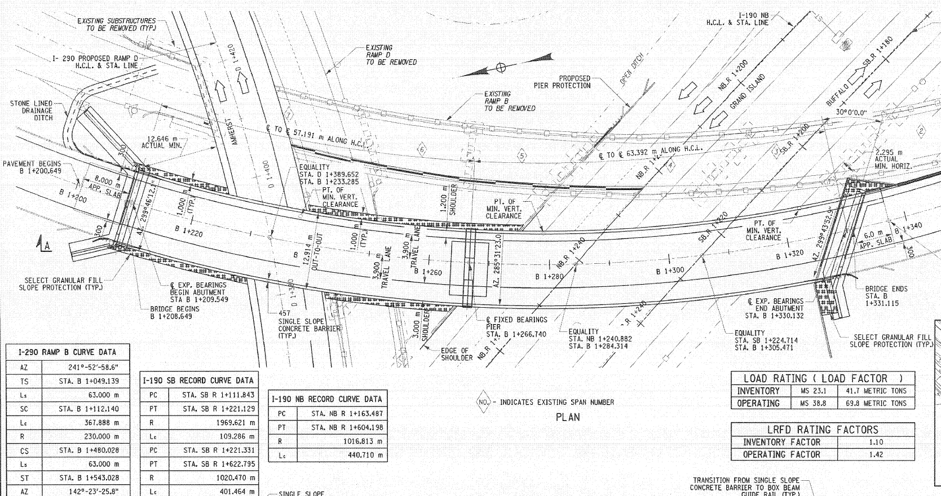
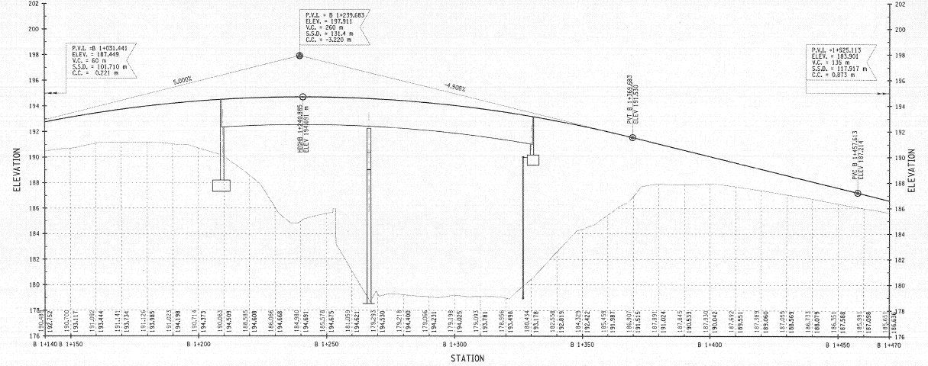
Plan & Profile View – I-290 Ramp B over I-190

Slide 14
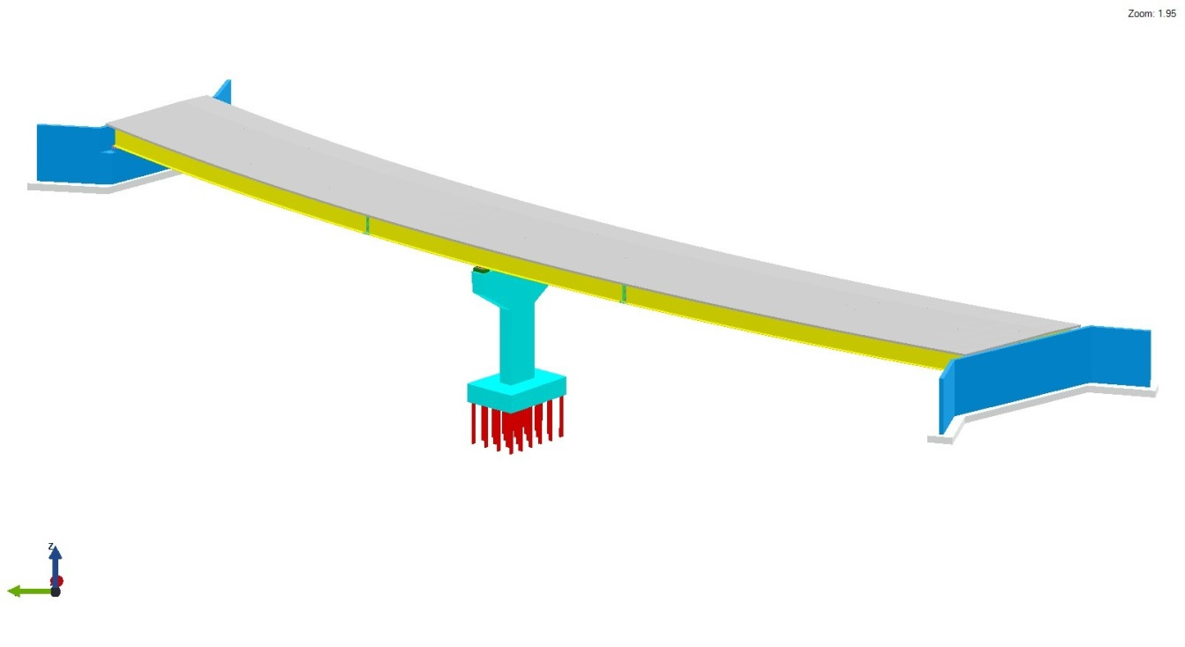
3D View – Case Study Bridge

Slide 15
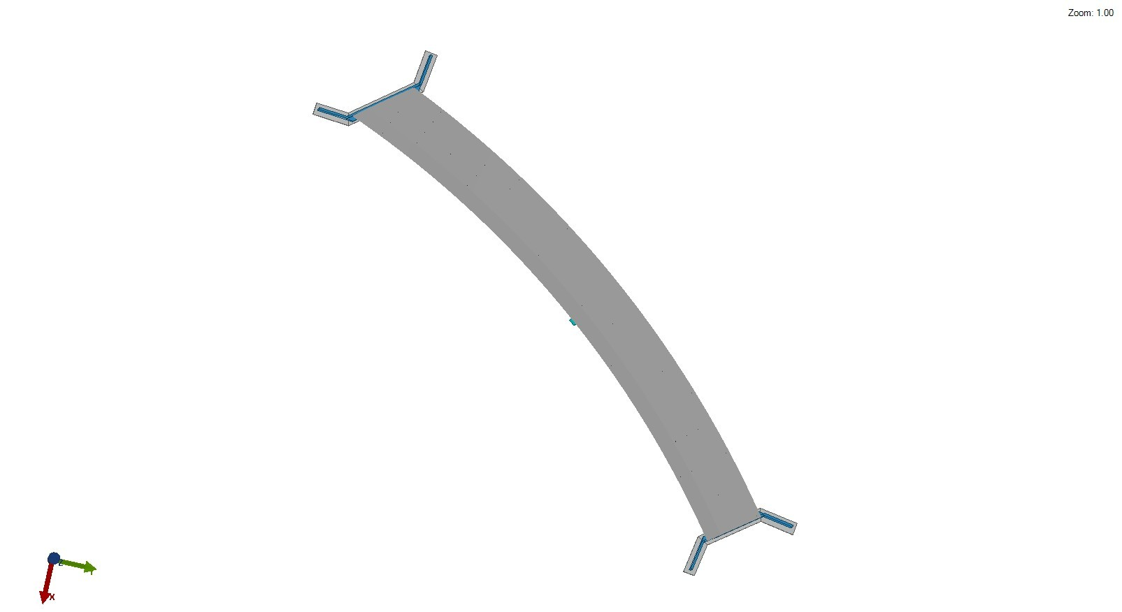
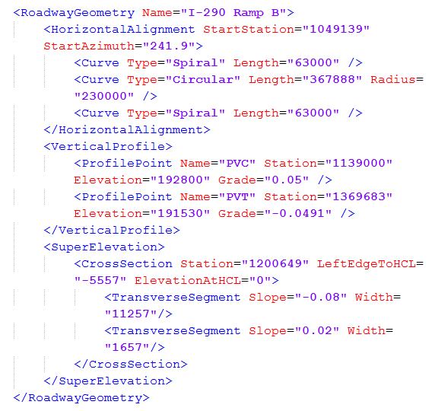
3D View – Case Study Bridge

Slide 16
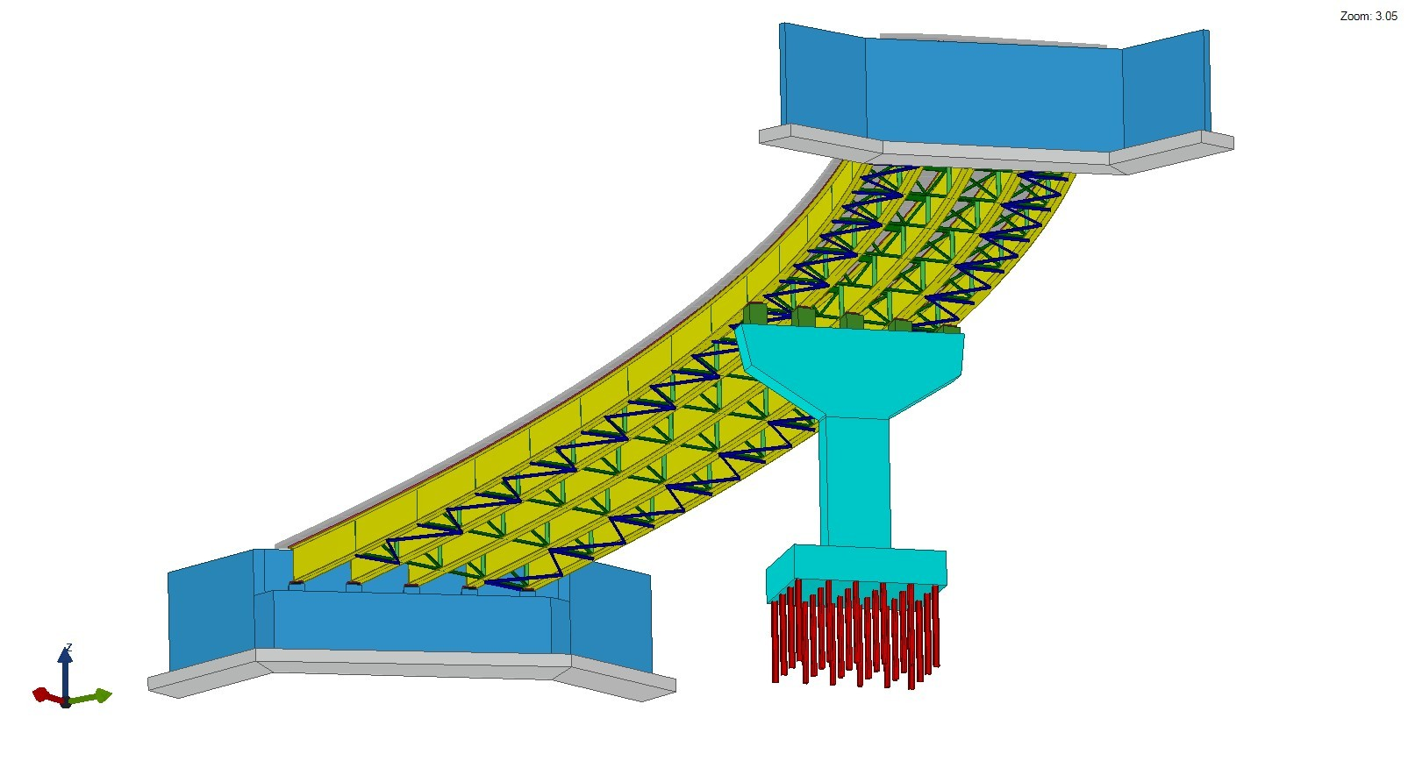
3D View – Case Study Bridge

Slide 17
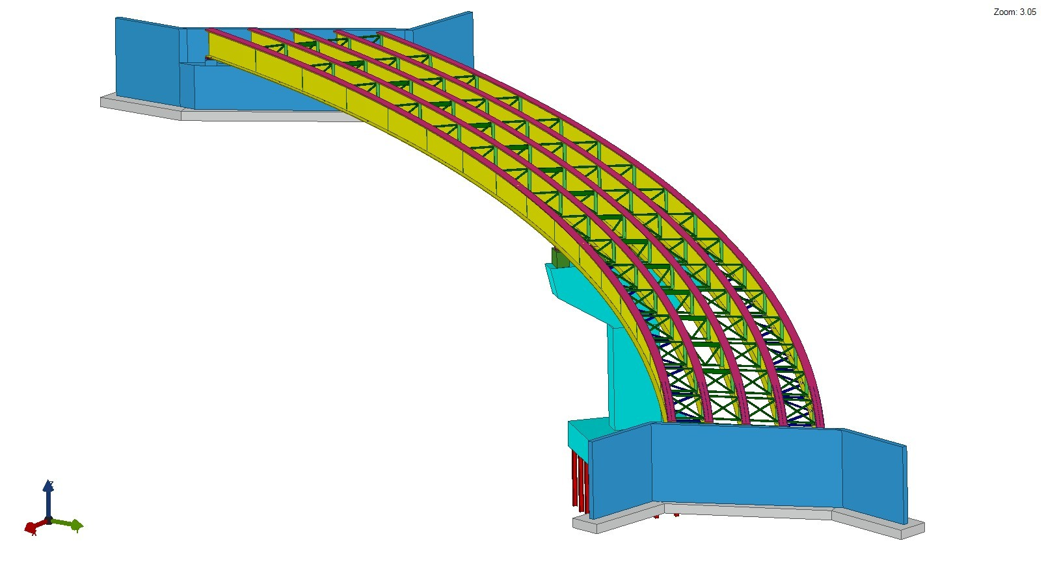
3D View – Case Study Bridge

Slide 18
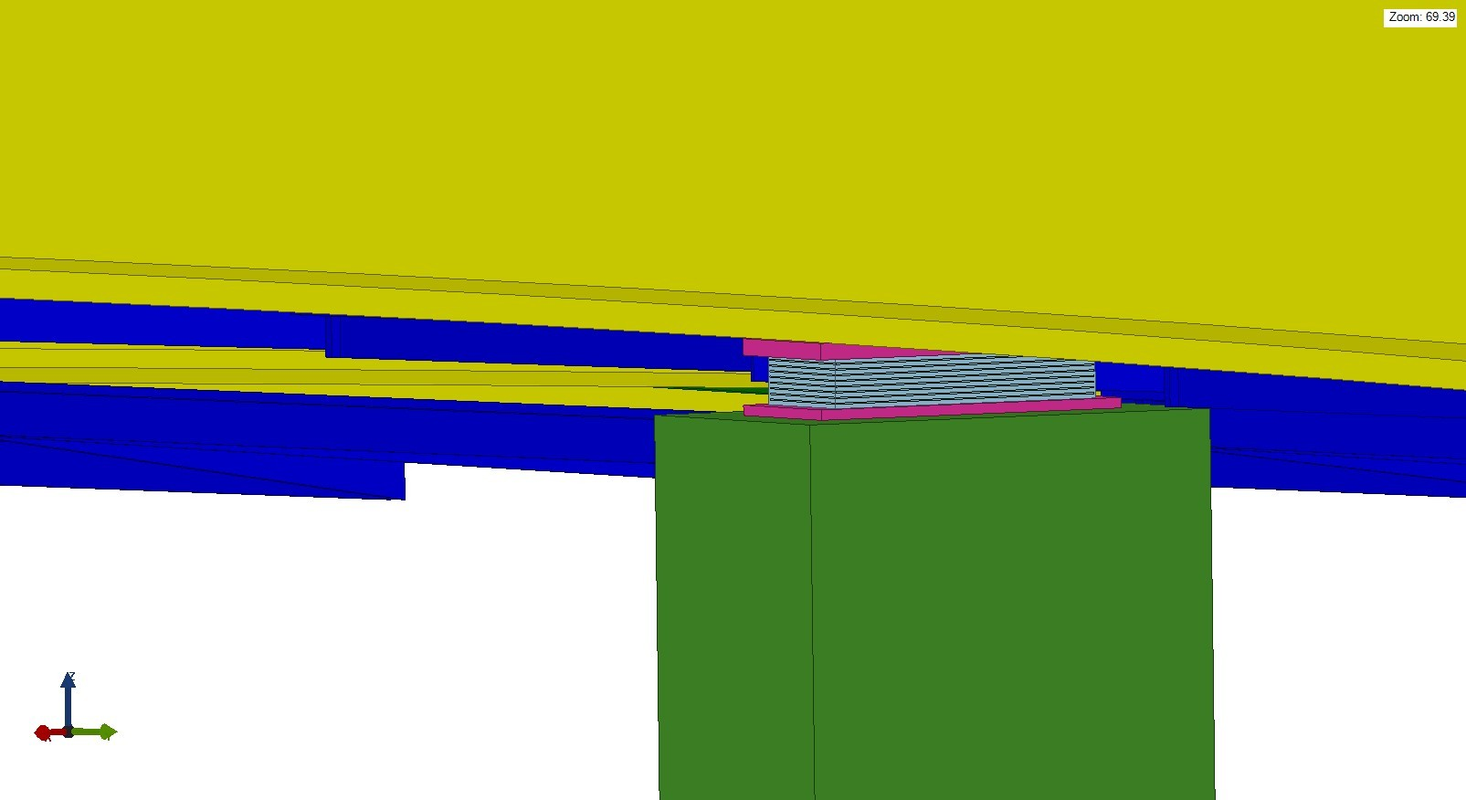
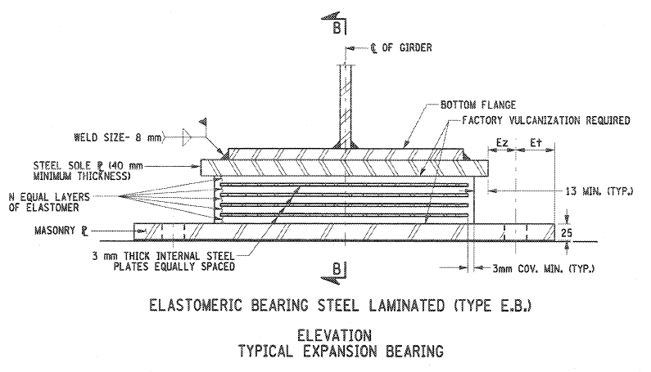
3D View – Bearing

Slide 19
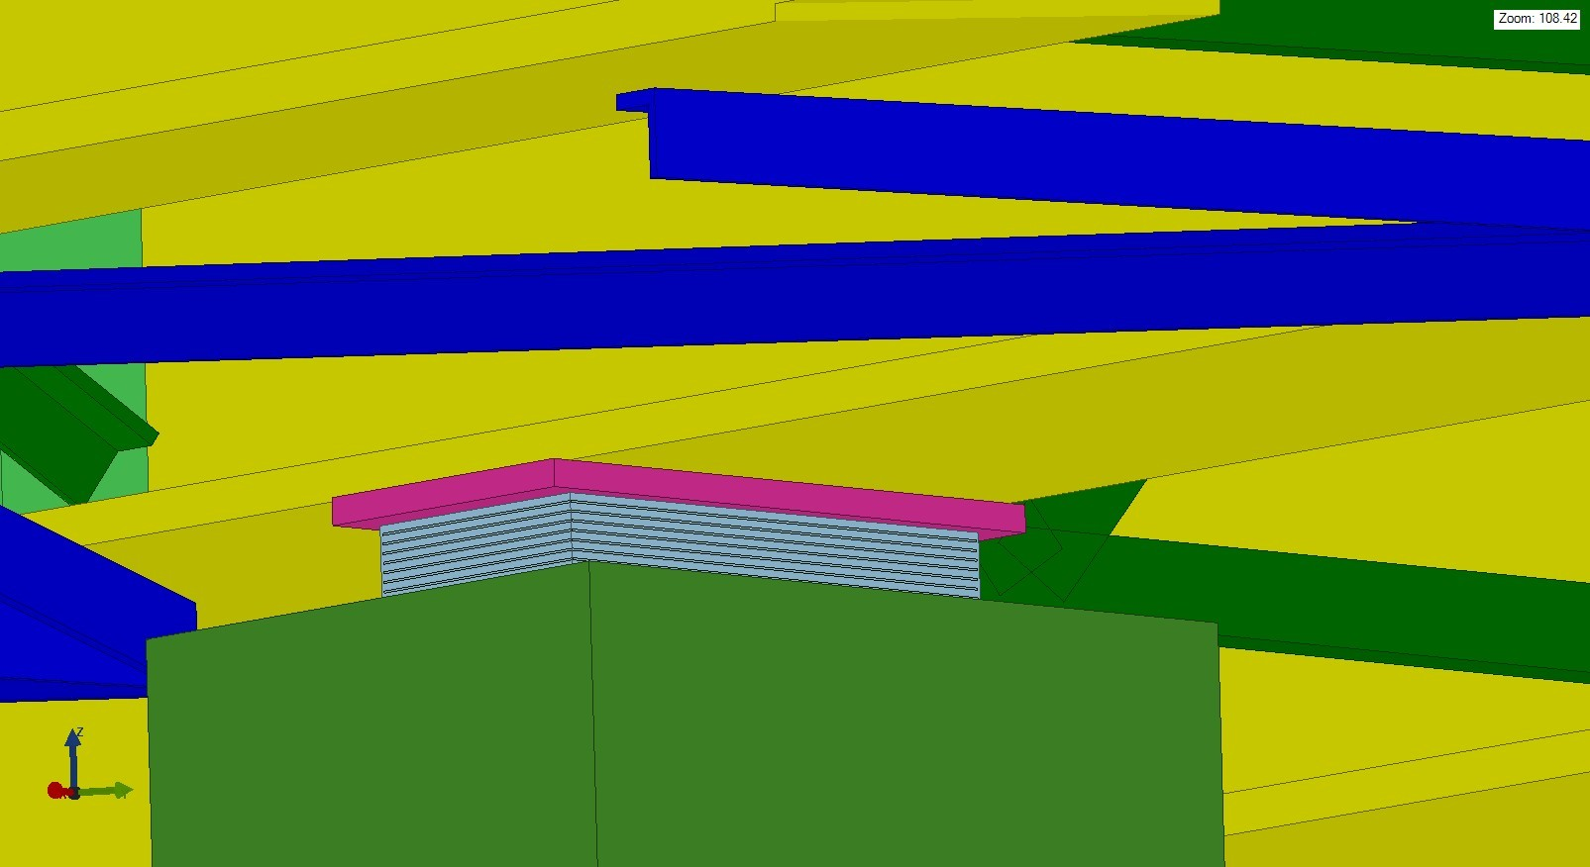
3D View – Bearing

Slide 20
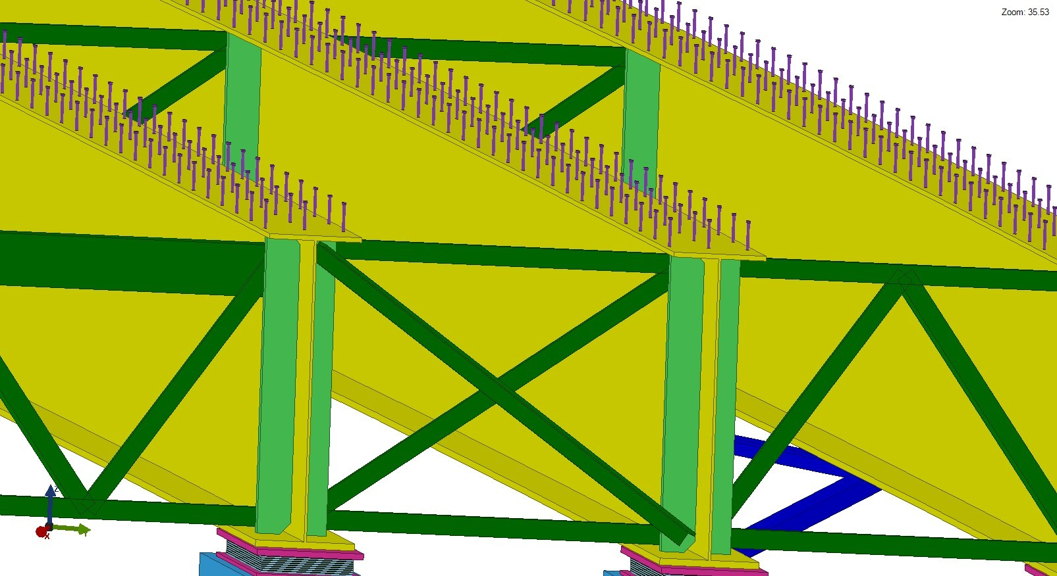
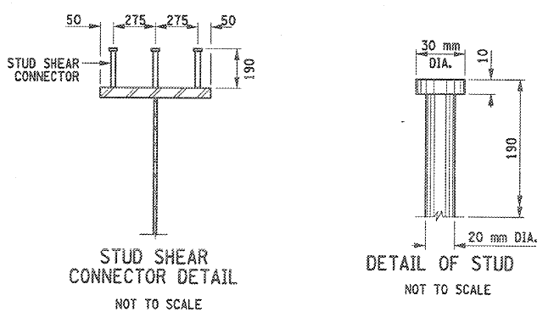
3D View – Shear Studs

Slide 21
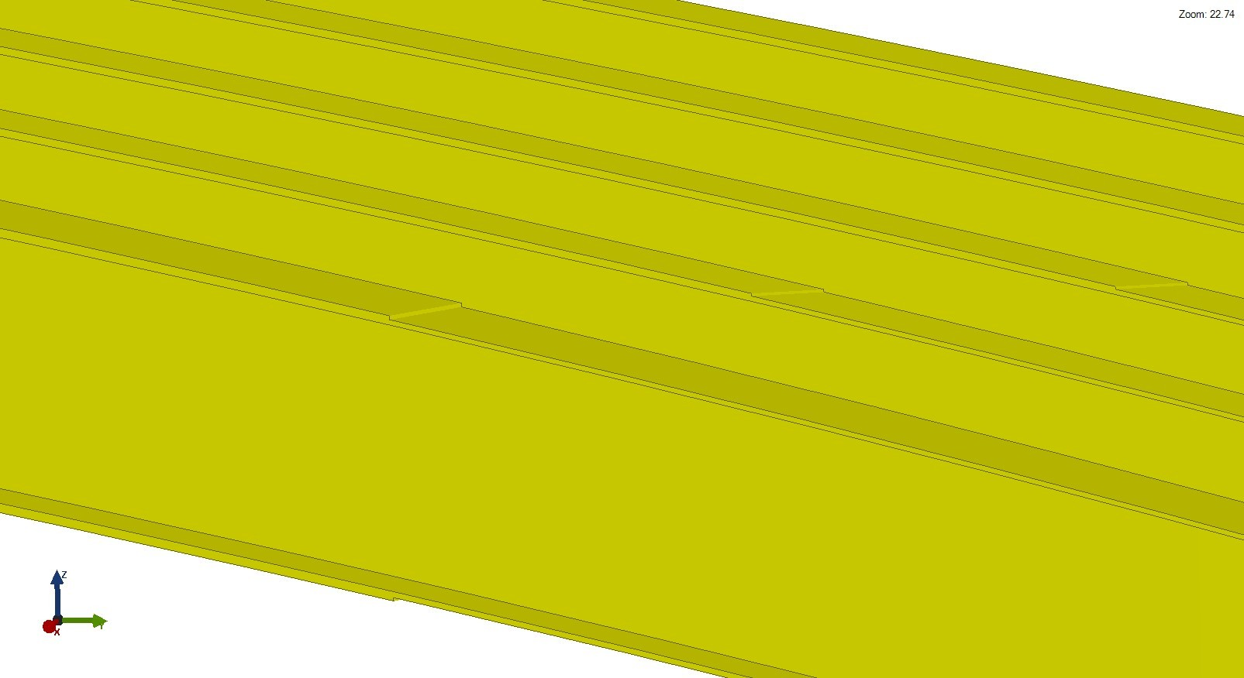
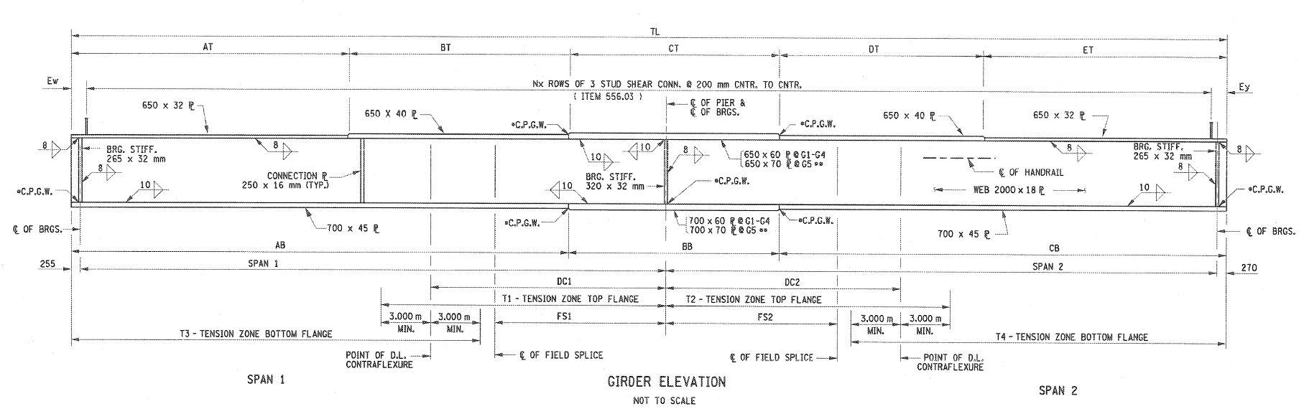
3D View – Flange Transition

Slide 22
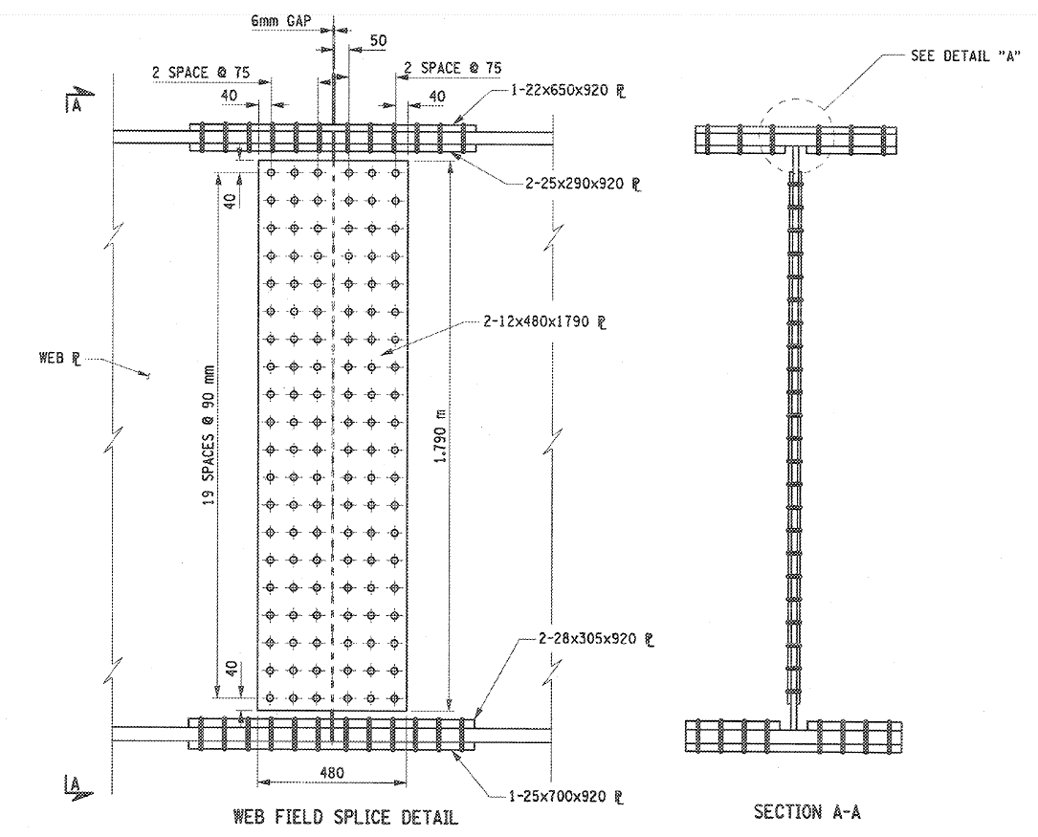


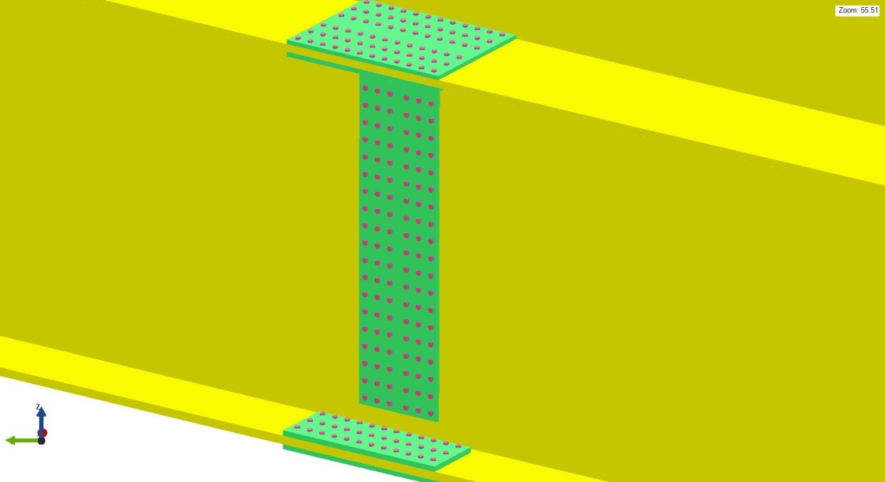
3D View – Bolted Field Splice

Slide 23
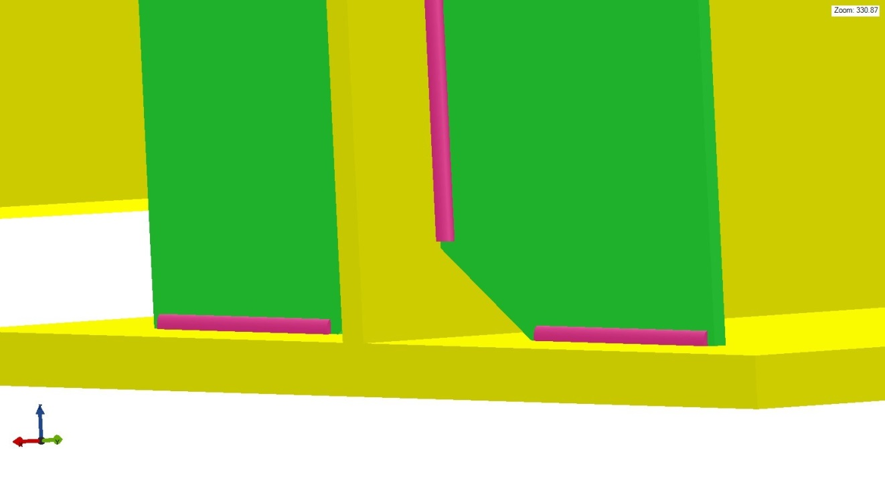
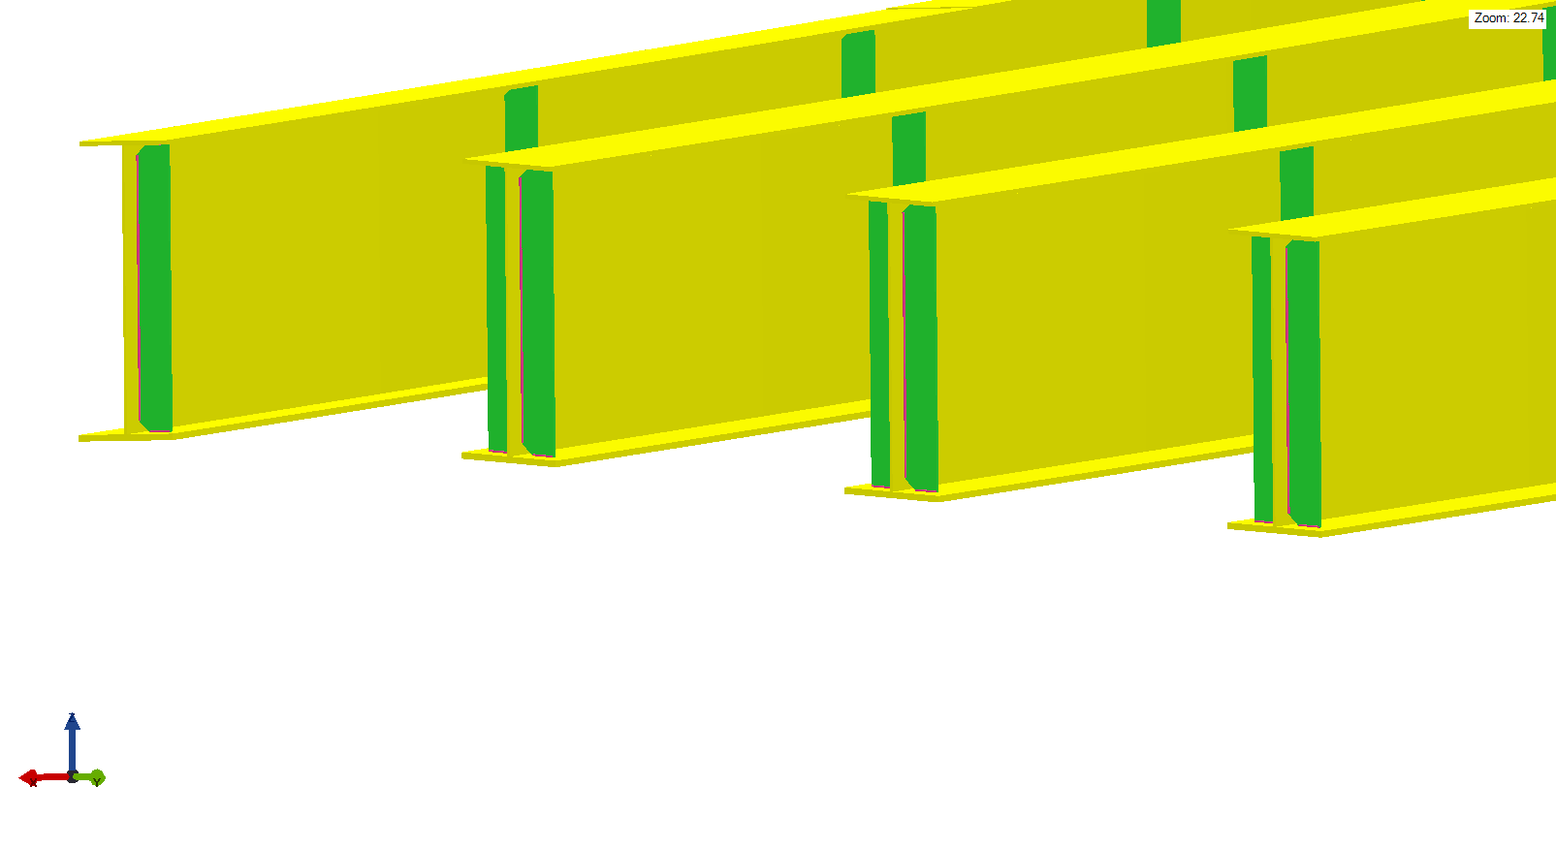
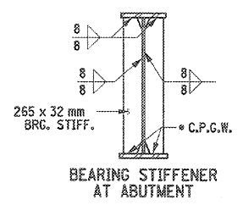
3D View – Weld Connection

Slide 24
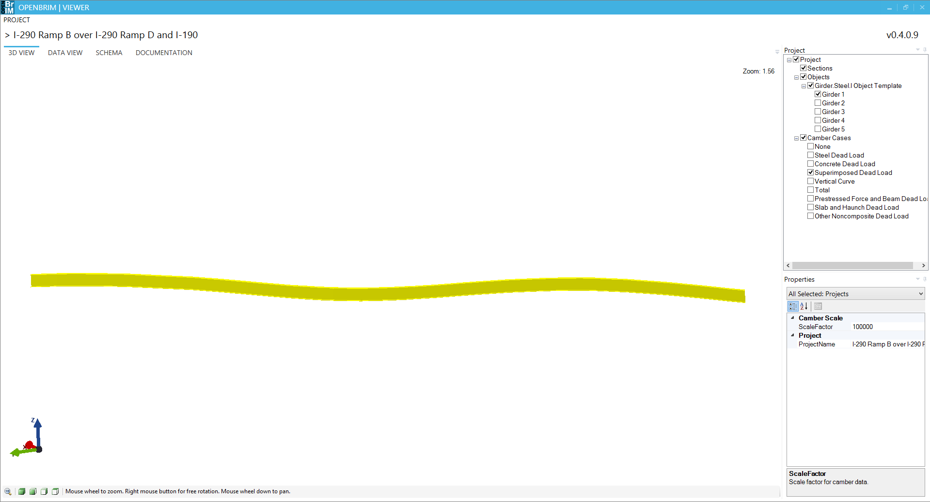
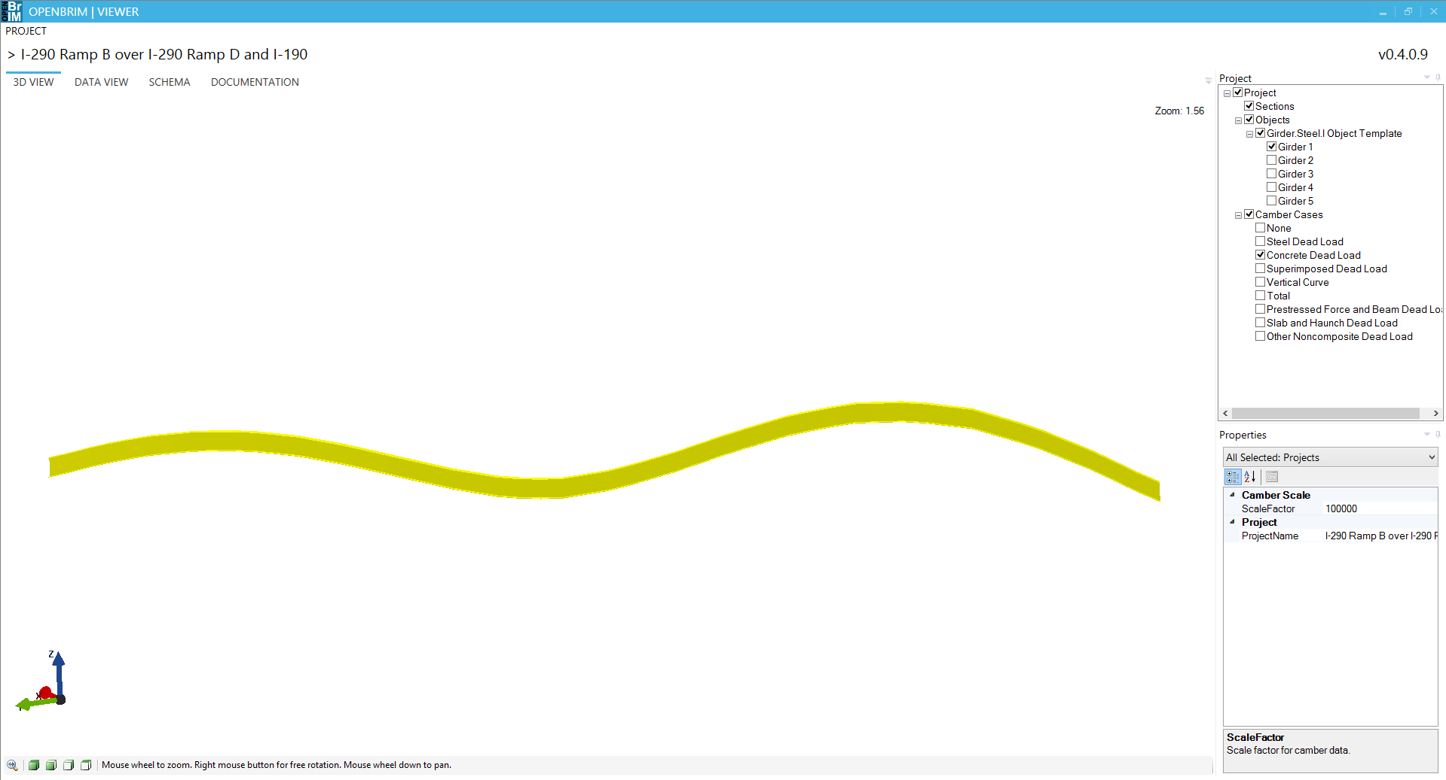
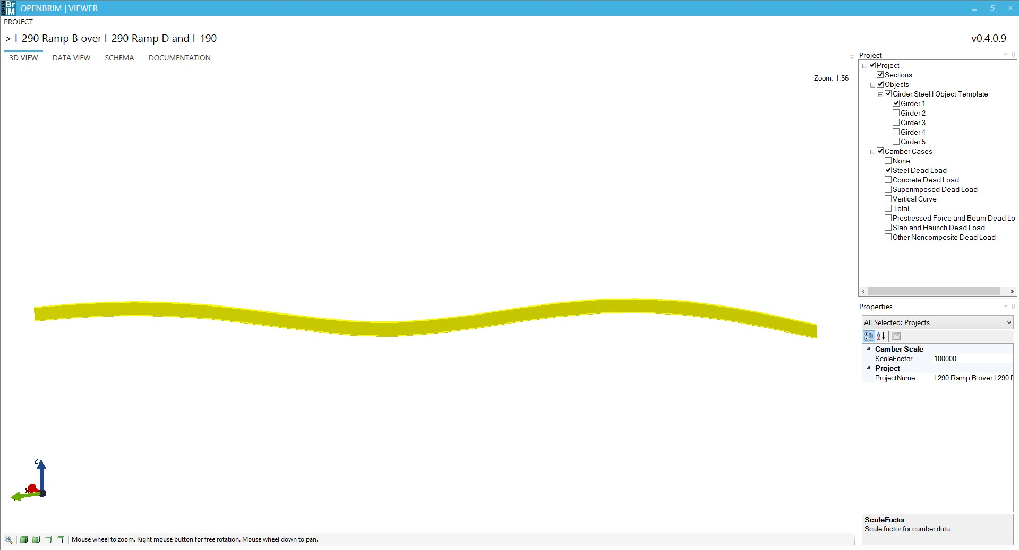
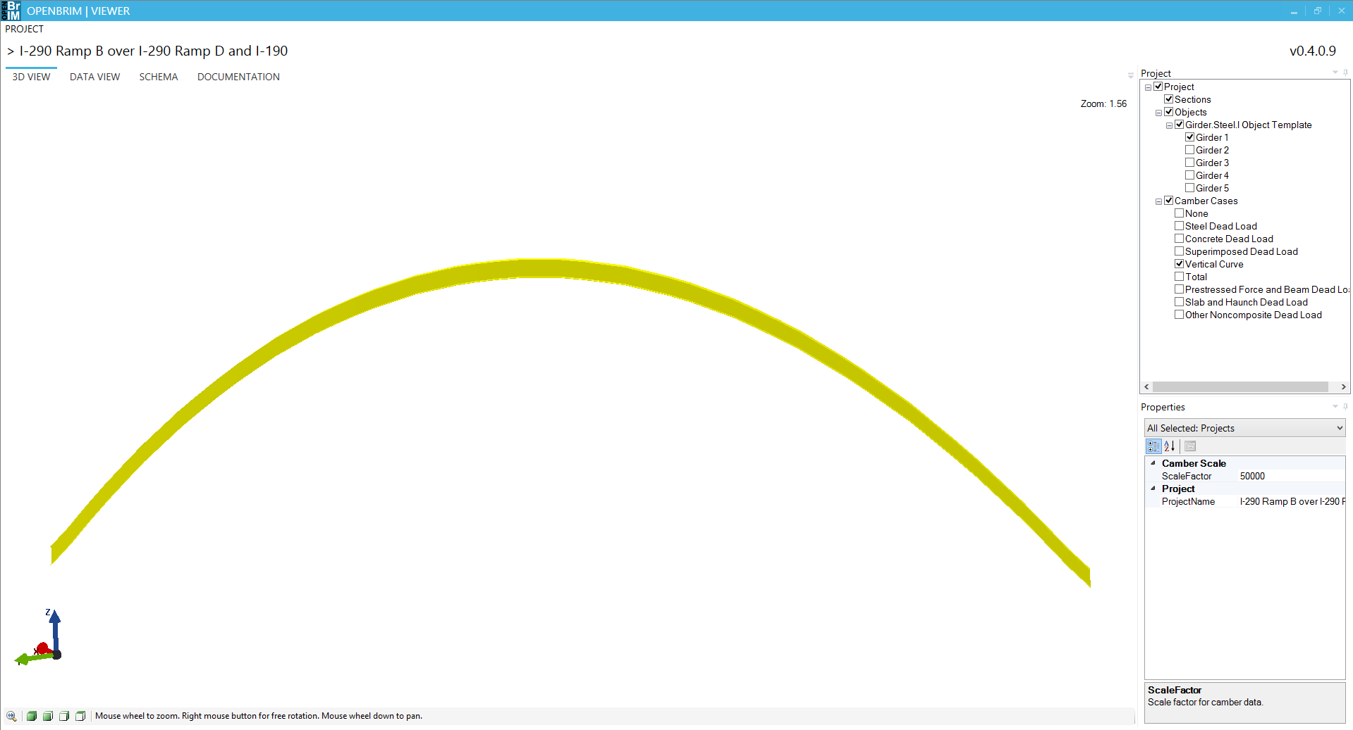
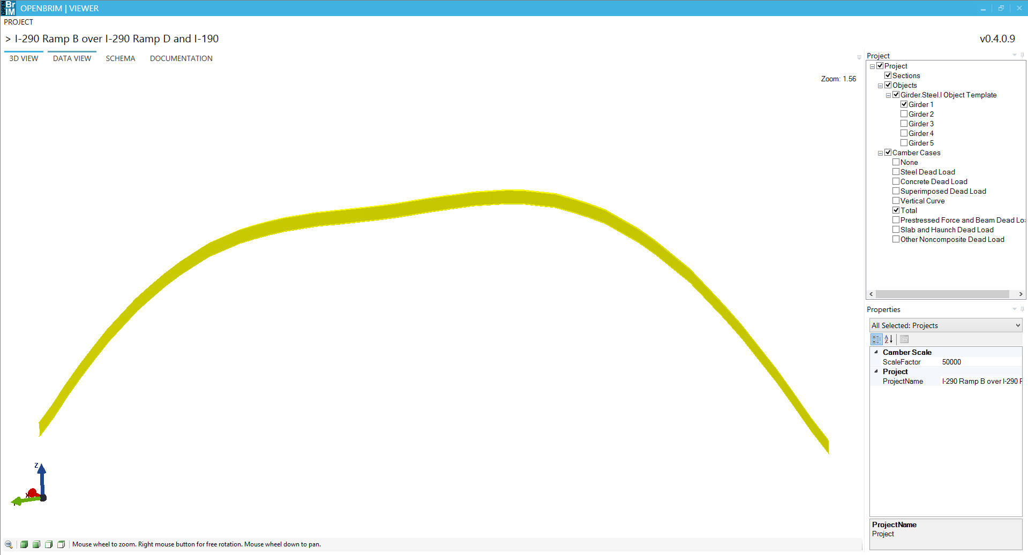

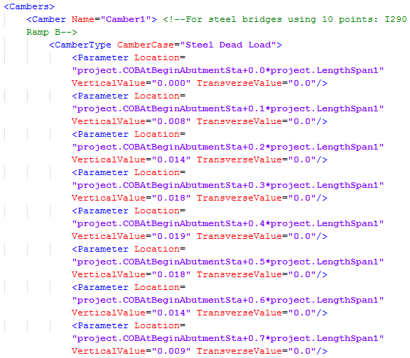
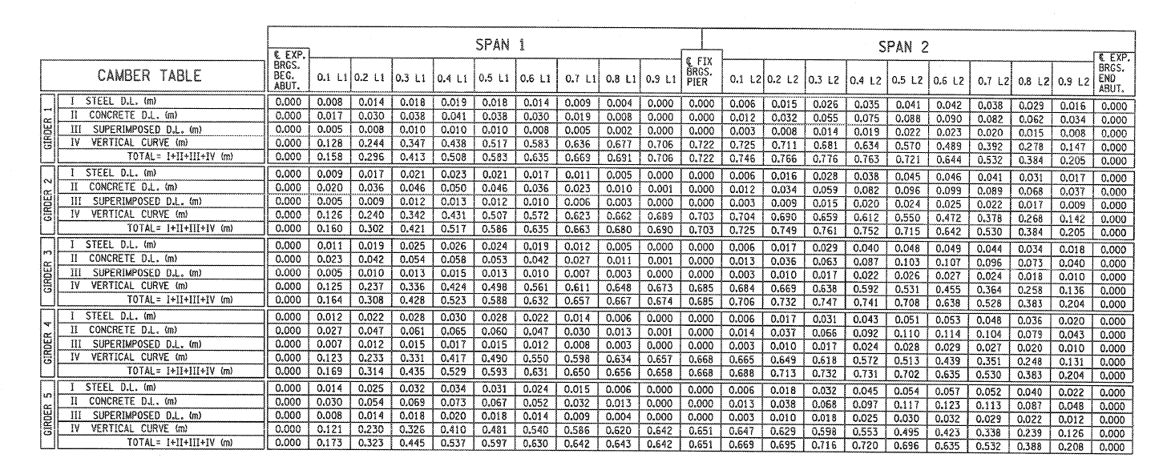
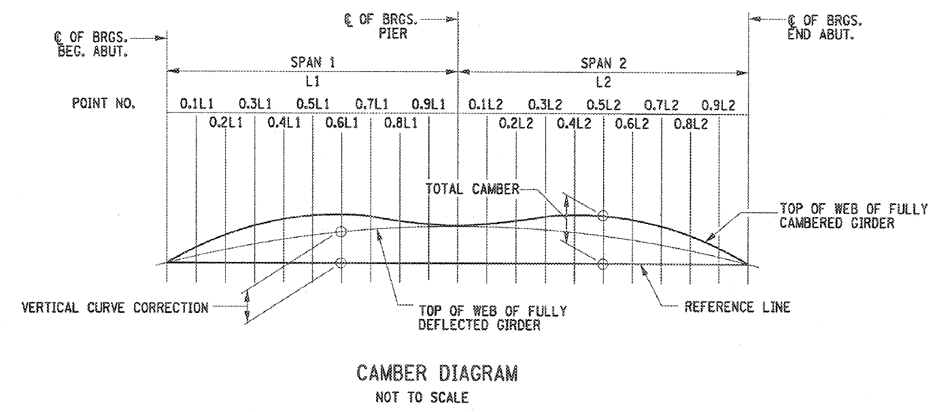
Vertical Curve
Total
Steel Dead Load
Original Case
Superimposed Dead Load
Concrete Dead Load
3D View – Camber

Slide 25
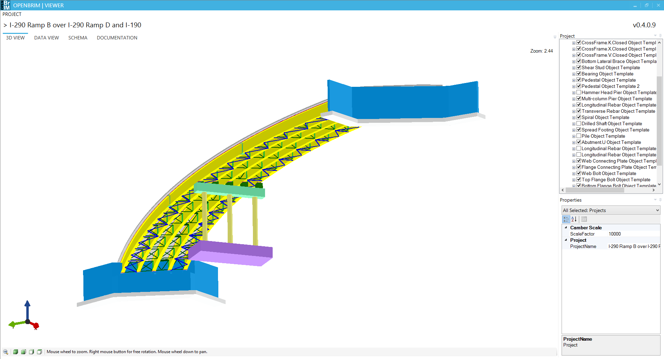
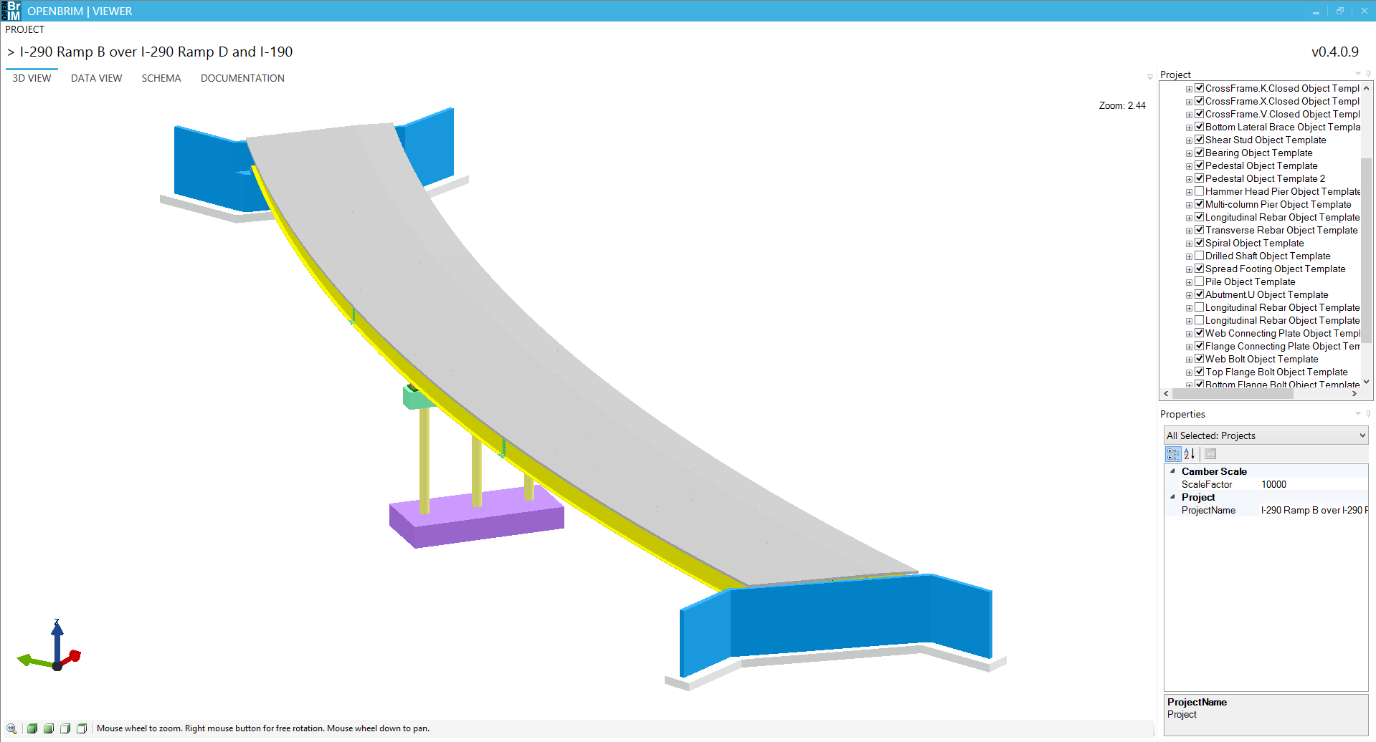
3D View – Alternative Multi-column Pier with Spread Footing

Slide 26
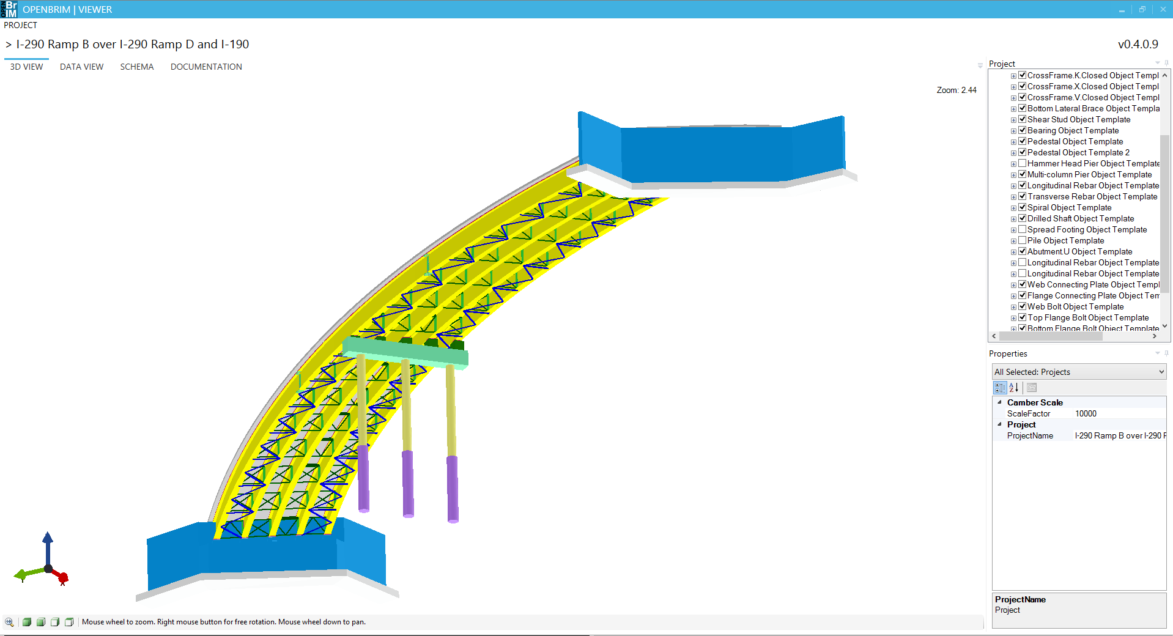
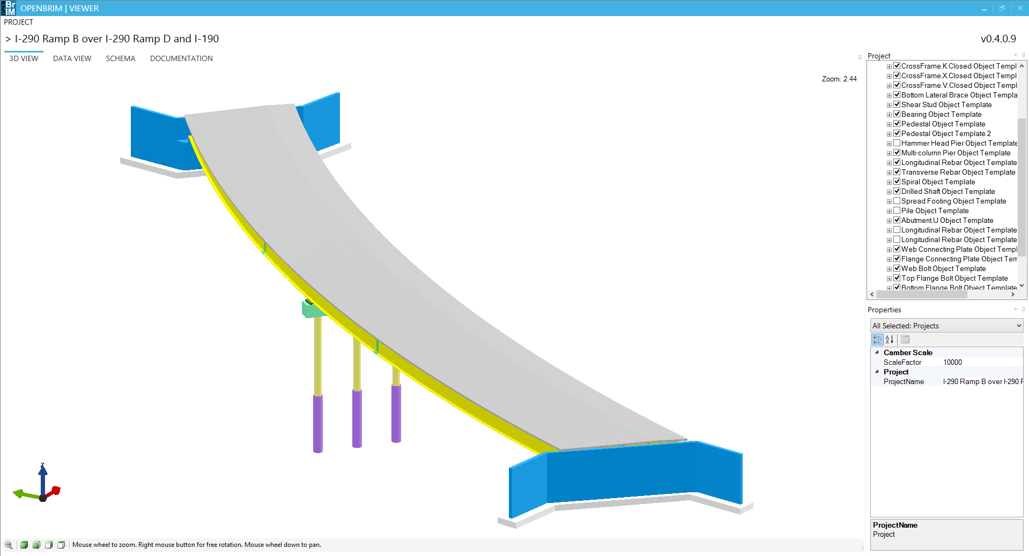
3D View – Alternative Multi-column Pier with Drilled Shafts

Slide 27
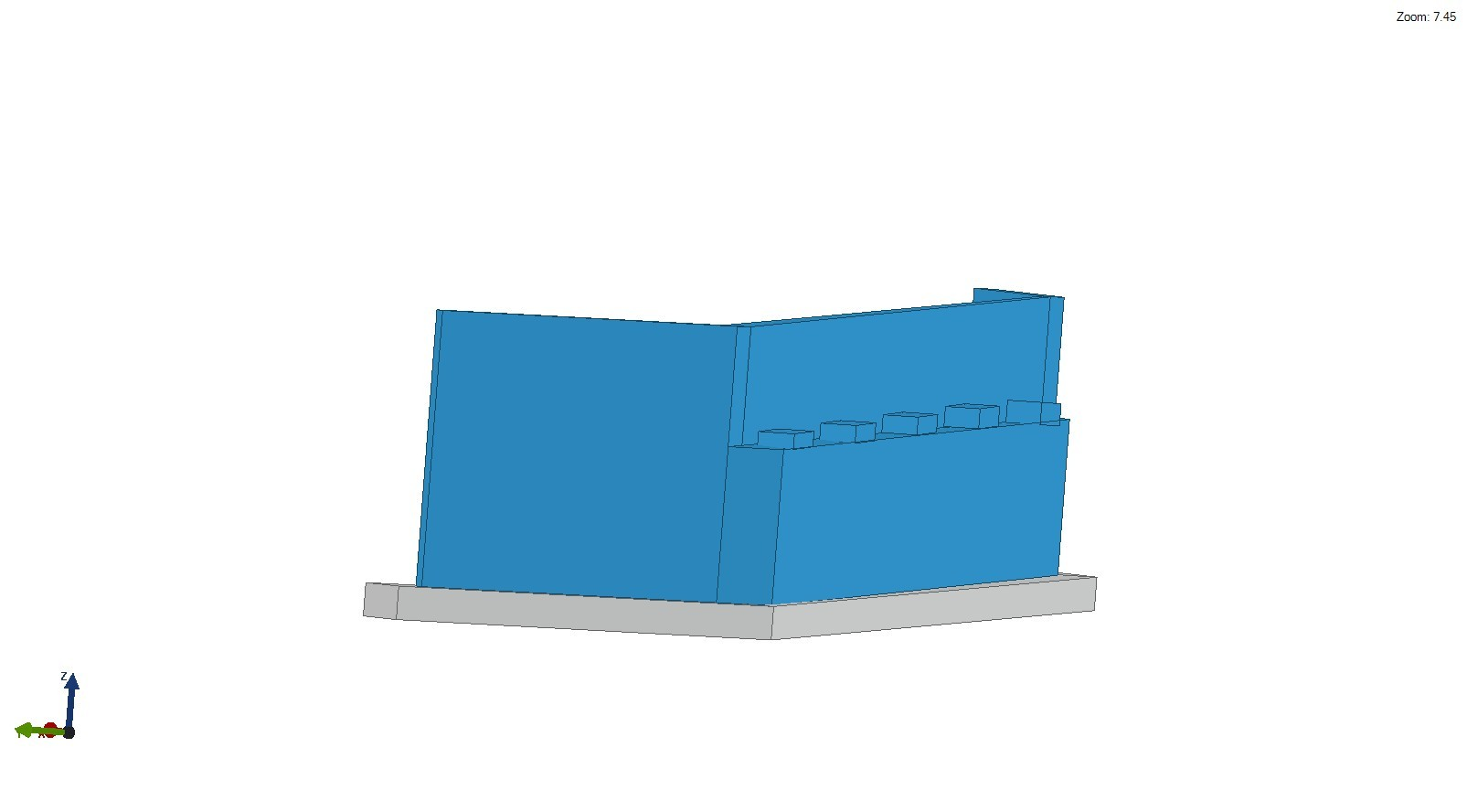
3D View – Abutment

Slide 28
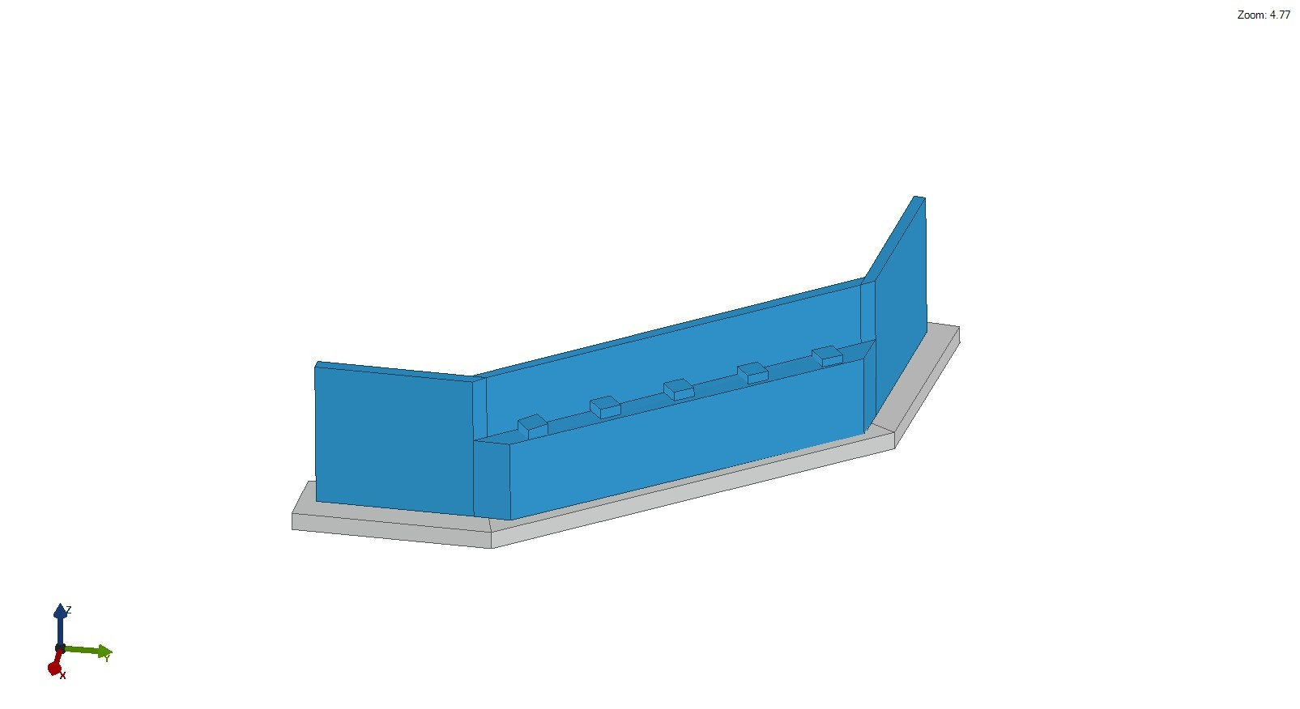
3D View – Abutment

Slide 29
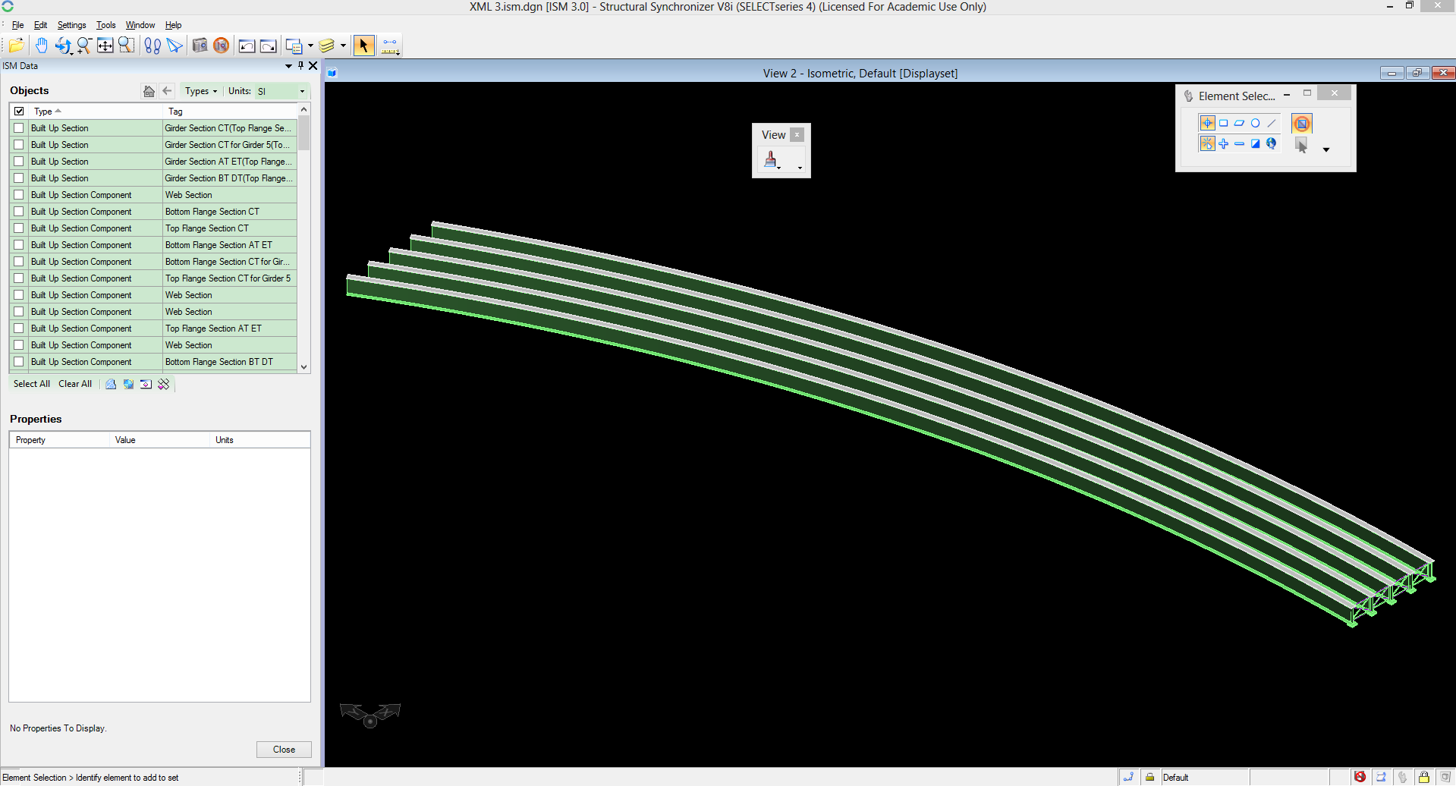
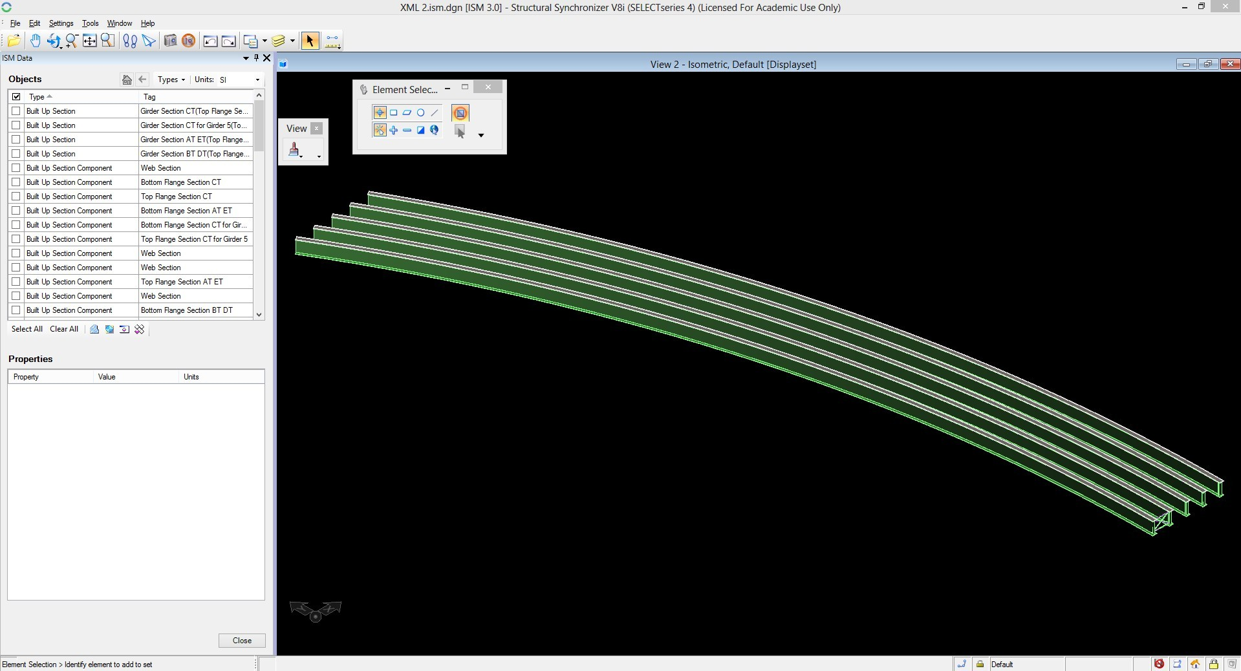
ISM Model of the Case Study Bridge

Slide 30
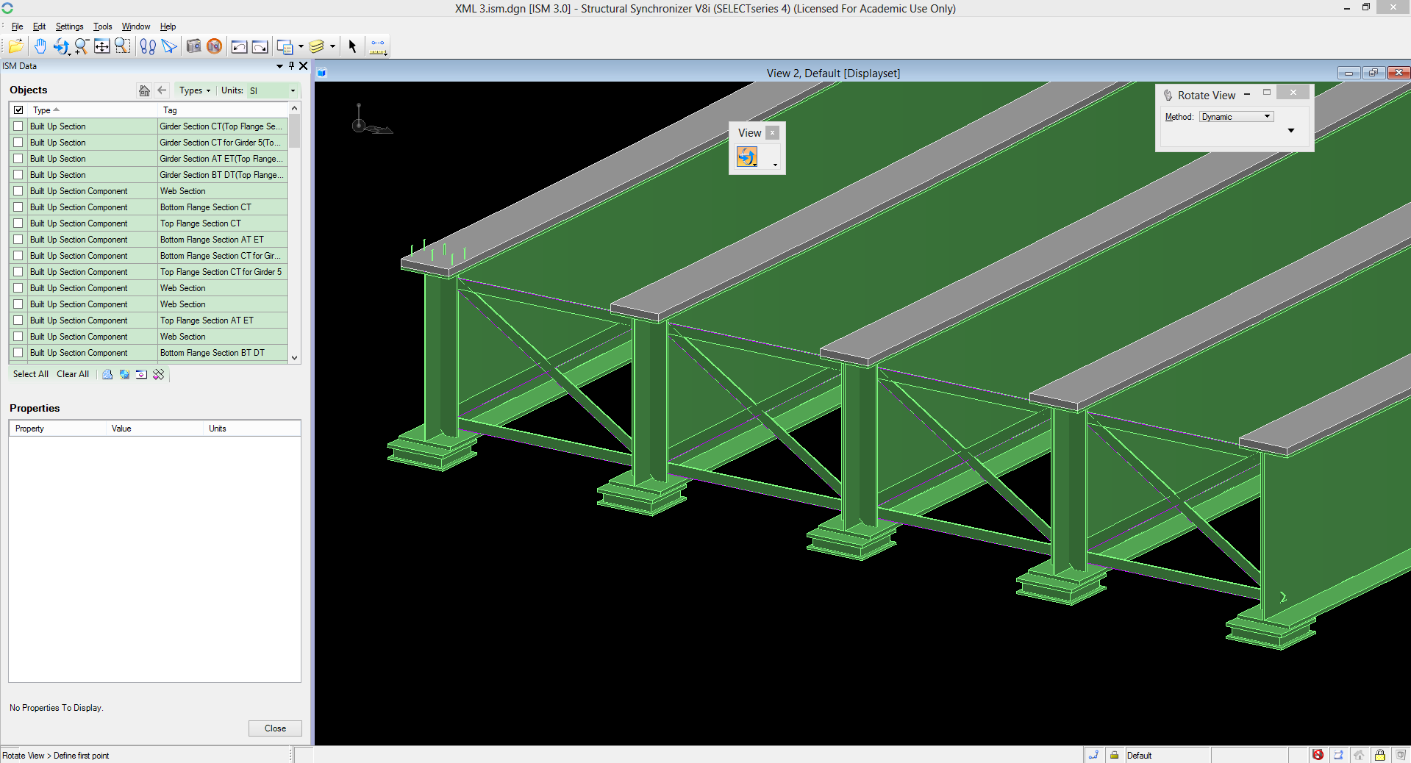
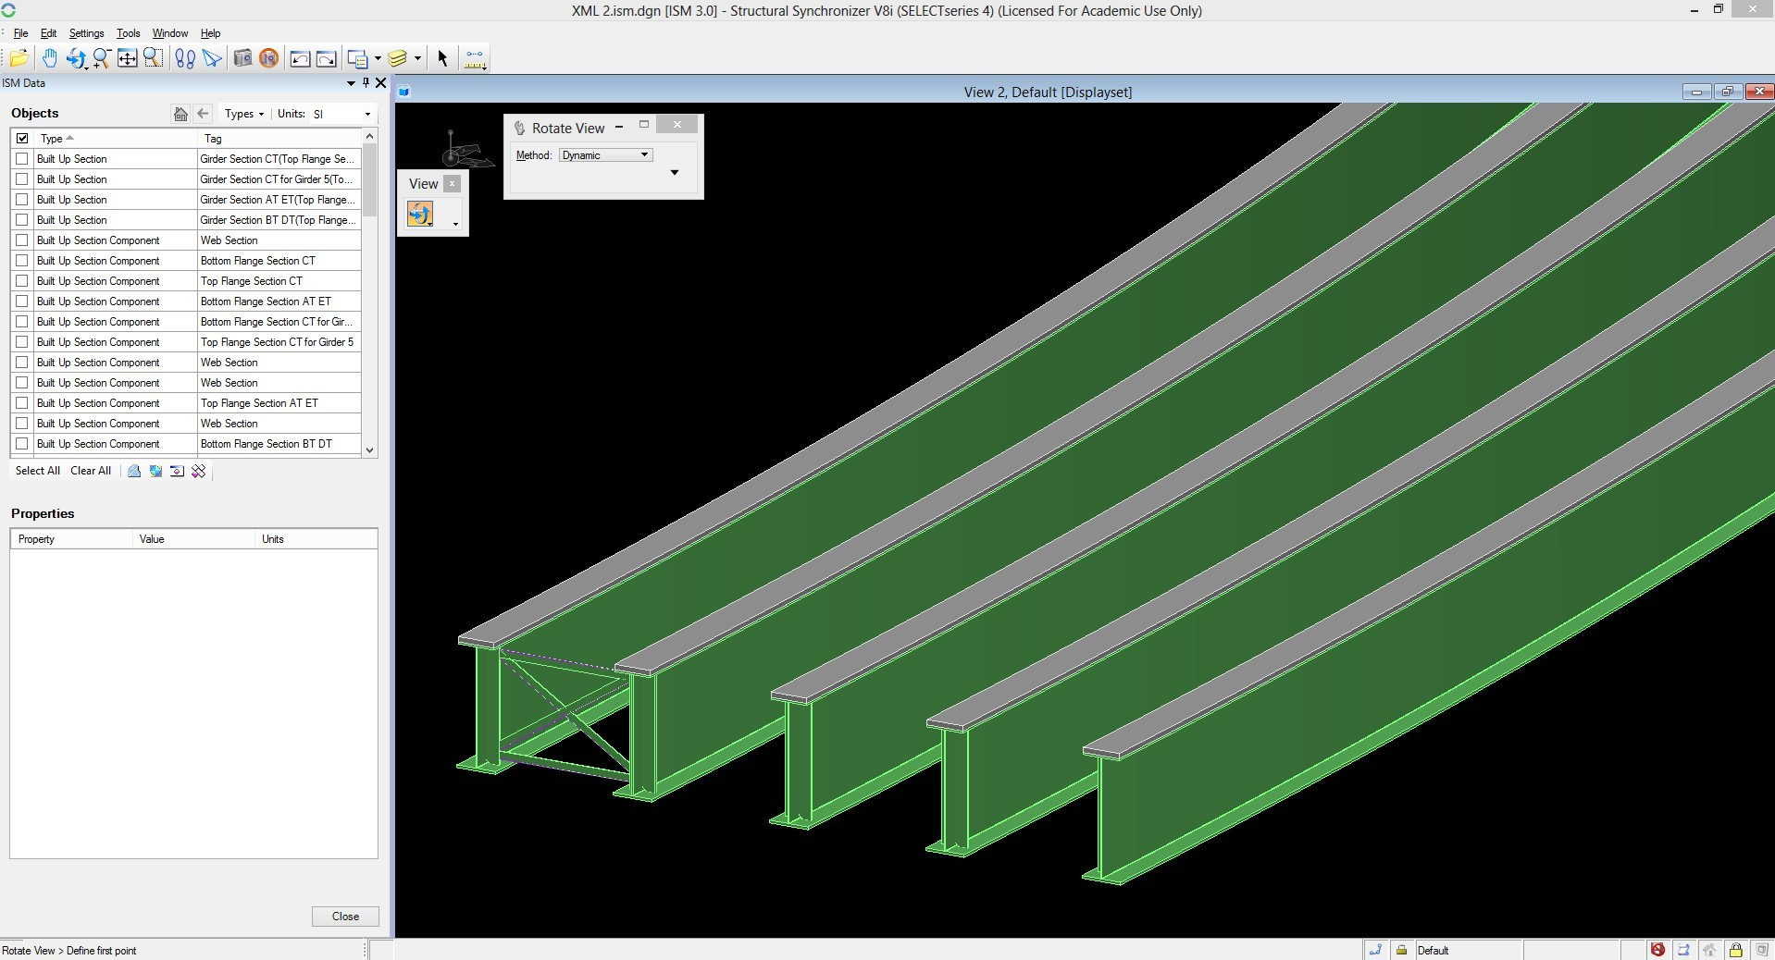
ISM (v. 3) Model of the Case Study Bridge

Slide 31
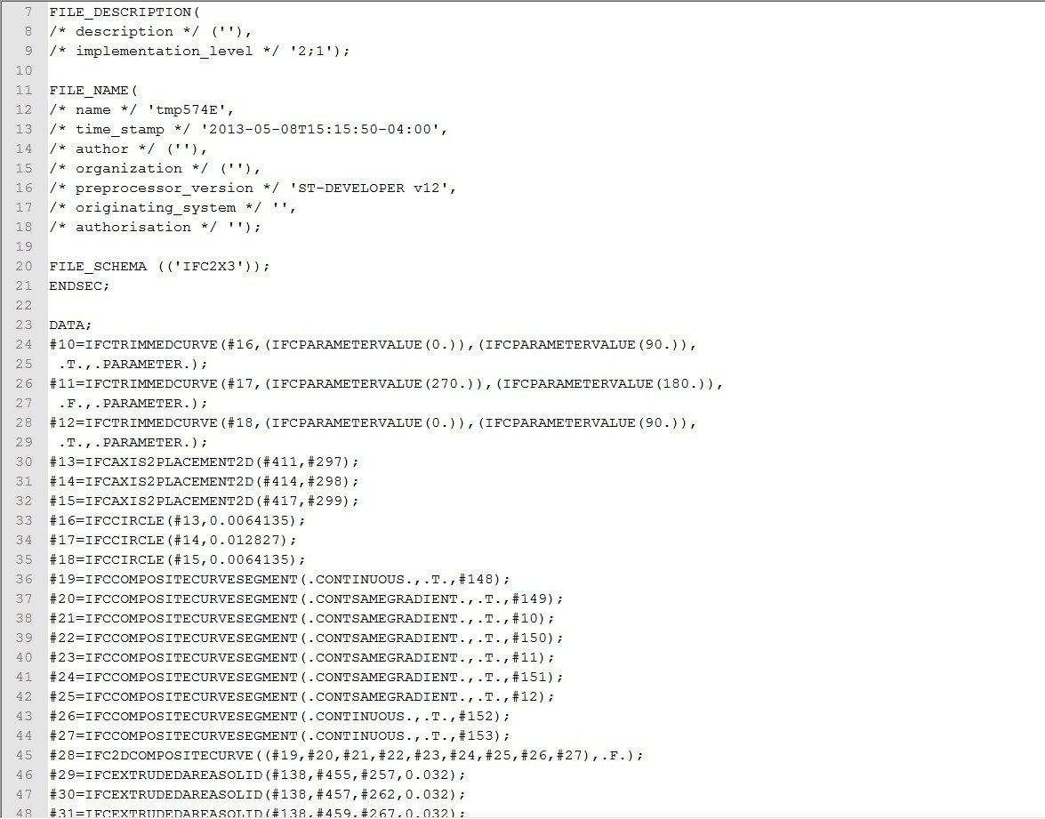
IFC file (v.2x3) of Case Study Bridge

Slide 32
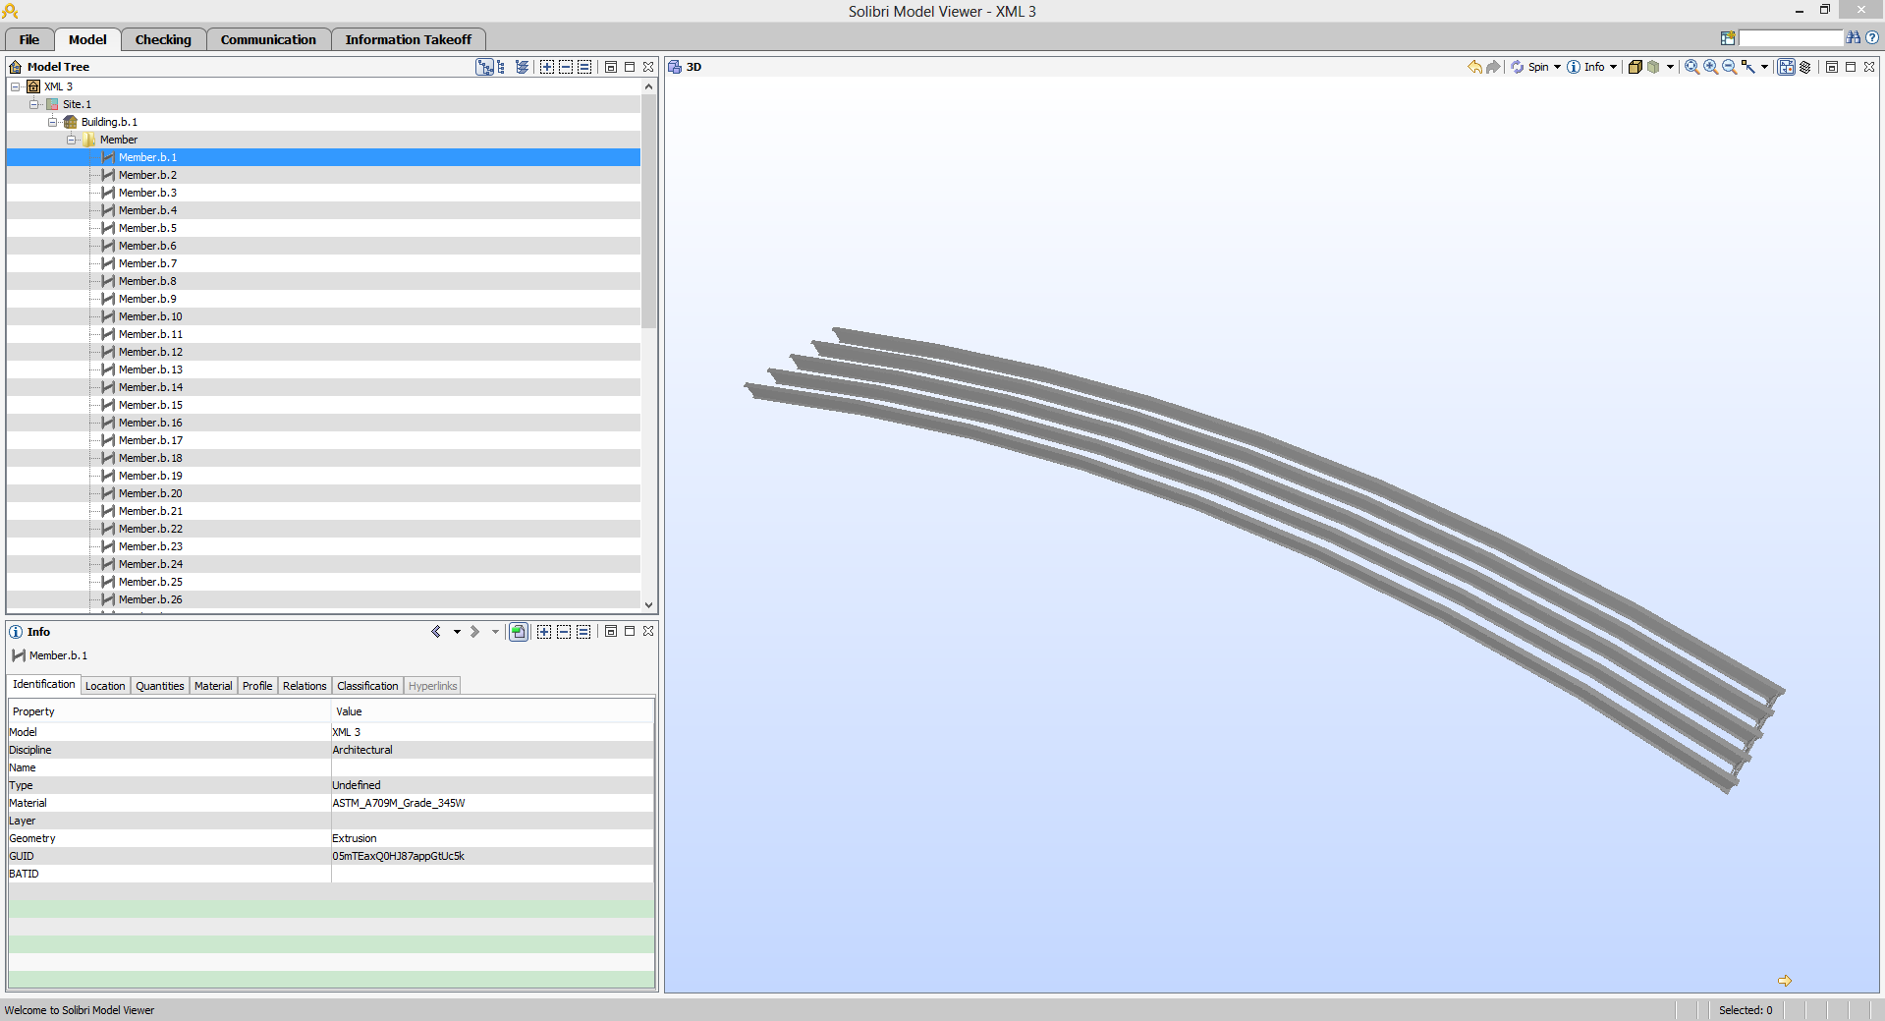
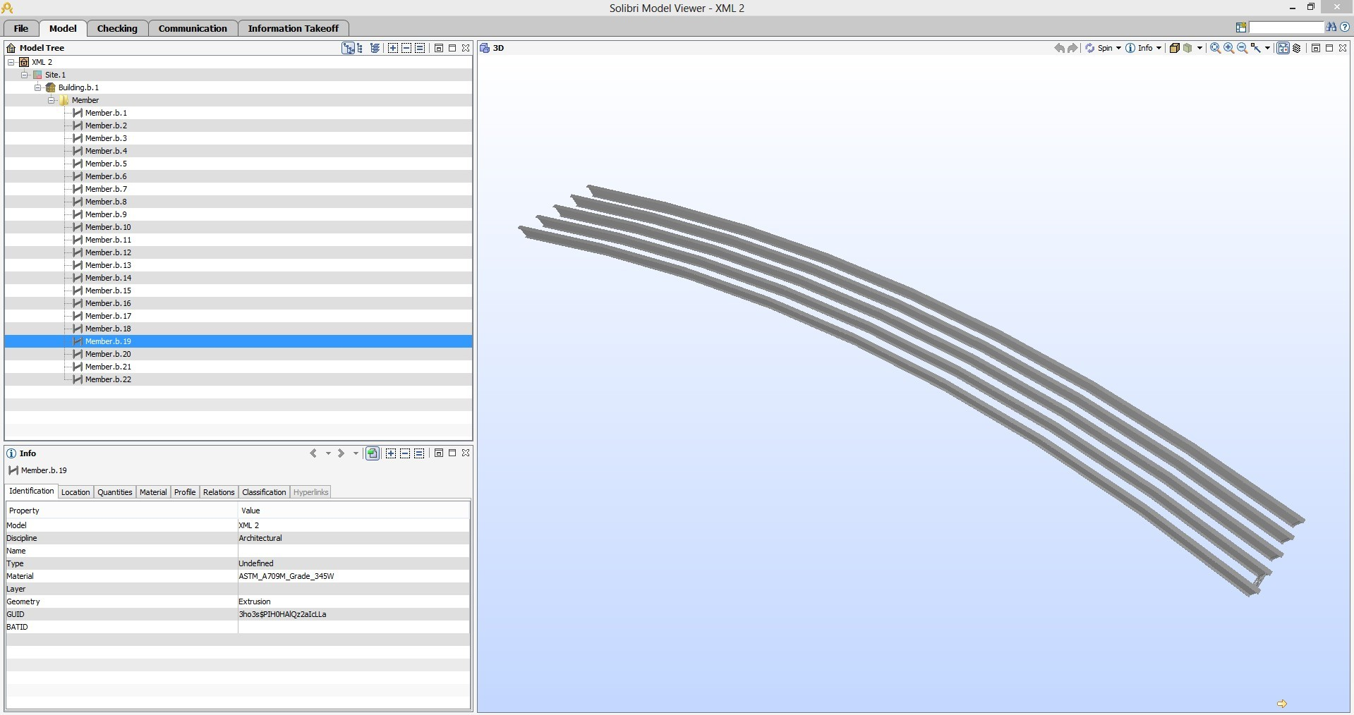
IFC Model of Case Study Bridge

Slide 33
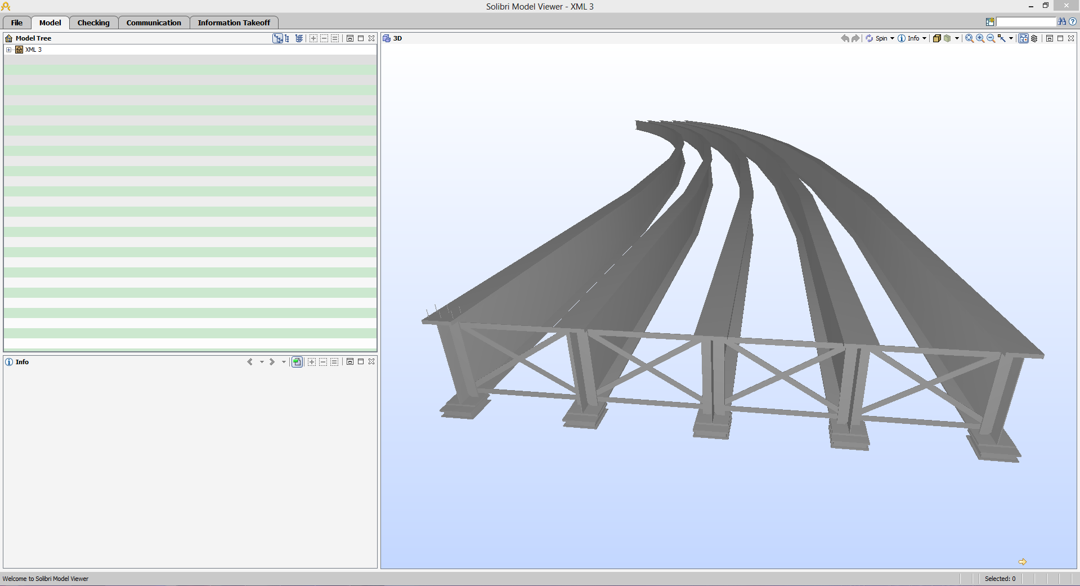


IFC Model of the Case Study Bridge

Slide 34



Reinforcement – Longitudinal, Tie, Spiral, Mat

Slide 35






Reinforcement and Prestressing Strands

Slide 36

Case Study Bridge – Quincy Ave over I-25

Slide 37

3D View – Case Study Bridge

Slide 38


3D View – Case Study Bridge

Slide 39

3D View – Case Study Bridge

Slide 40

3D View – Case Study Bridge

Slide 41

3D View – Case Study Bridge

Slide 42

3D View – Case Study Bridge

Slide 43


Slide 44

Project Data File: Annotated Glimpse

Slide 45

Project Template File: Annotated Glimpse

Slide 46


Slide 47


Slide 48
Make sure data of interest to you is included!
https://www.transportationresearch.gov/dot/fhwa/SitePages/register.aspx

Slide 49





For word document, highlight the context, right click and then choose comment
The link will take you to the documents of this project.
A link to the documents will be sent to your mail box.
For Excel document, right click on one cell and choose insert comment
Click on them to open
AASHTO/NSBA Steel Bridge Collaboration - Team Site

Slide 50
Acknowledgements
Federal Highway Administration (B. Kozy, COTR) through ATLSS
Association for Bridge Construction and Design
New York State Department of Transportation & other DOTs
Bentley Systems, Red Eqn Corp., and other Bridge Software Solution Providers
University at Buffalo, Istanbul Technical University, and University of Engineering and Technology
Others on UBrIM team: A. M. Shirole’, I.-S. Ahn, S. G. Karaman, Y. Ji, A. Nilsen
A. Koc
AASHTO/NSBA Collaboration (TG-15 Data Modeling for Interoperability)
Various other stakeholders
Etc.

